Slide 1
⛈️🔥
Comprendere il cambiamento climatico
con Python
🐍
Robin Castellani 🦎

Slide 2
Cos’è il cambiamento climatico?
«Per “cambiamenti climatici” si intendono i cambiamenti a lungo termine delle temperature e dei modelli meteorologici. »
Cit. Nazioni Unite - Centro Regionale di Informazioni
https://unric.org/it/che-cosa-sono-i-cambiamenti-climatici/

Slide 3
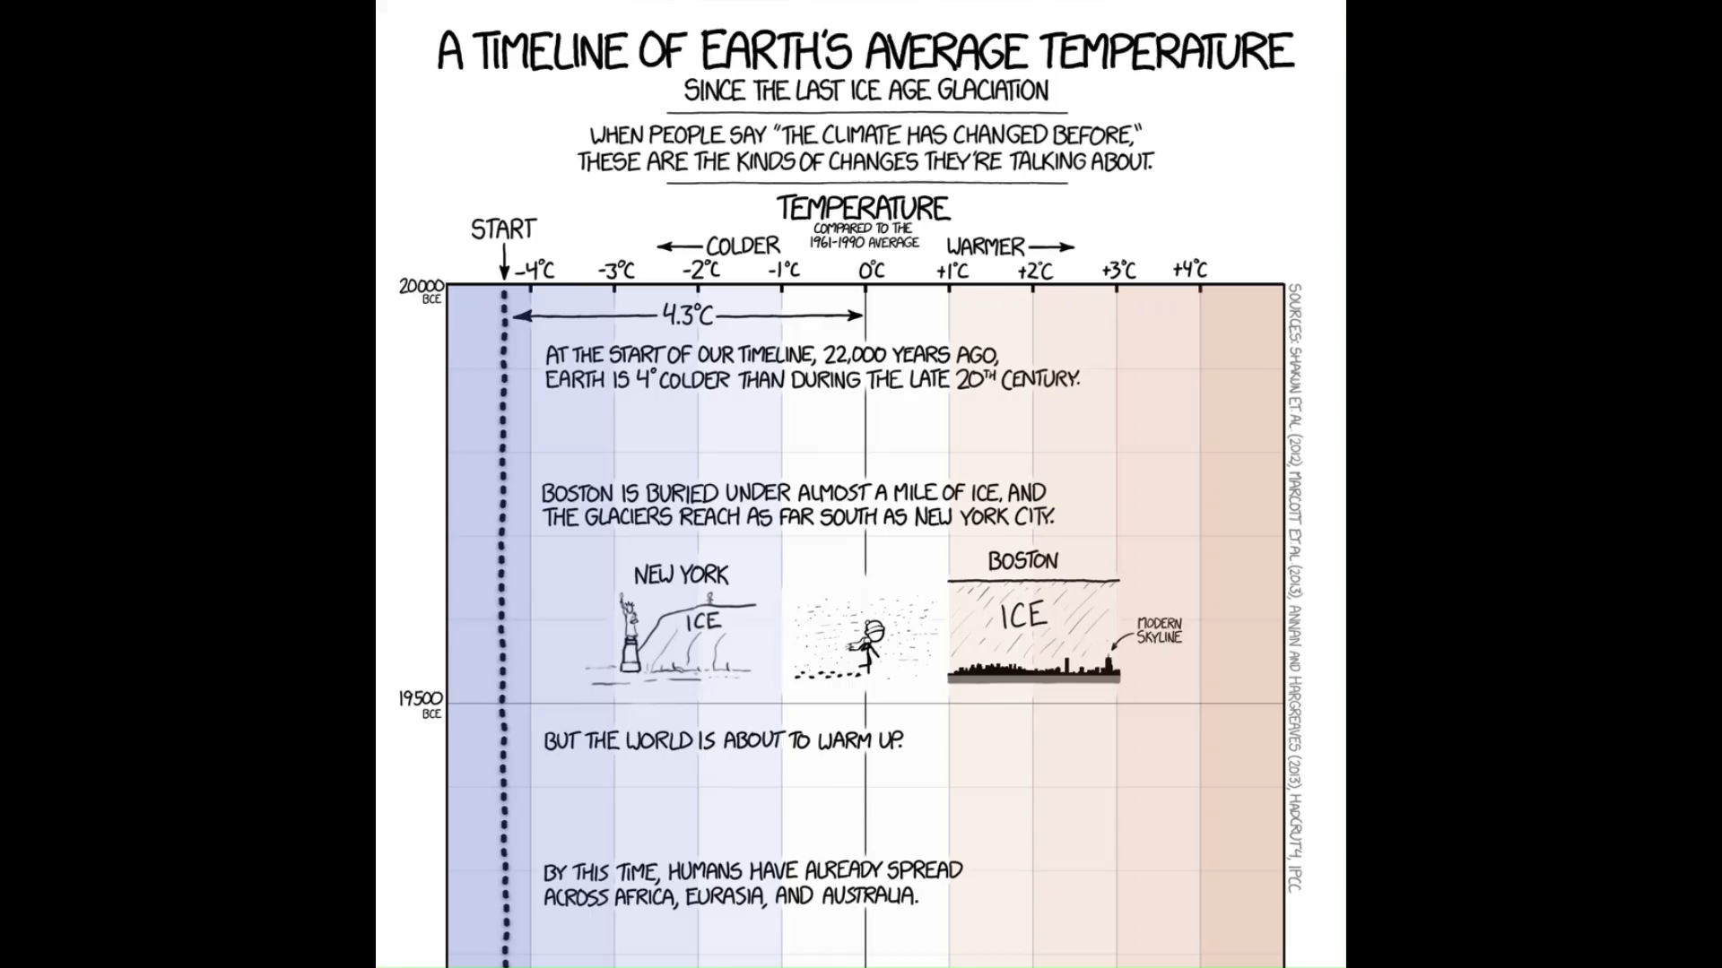
https://xkcd.com/1732/

Slide 4
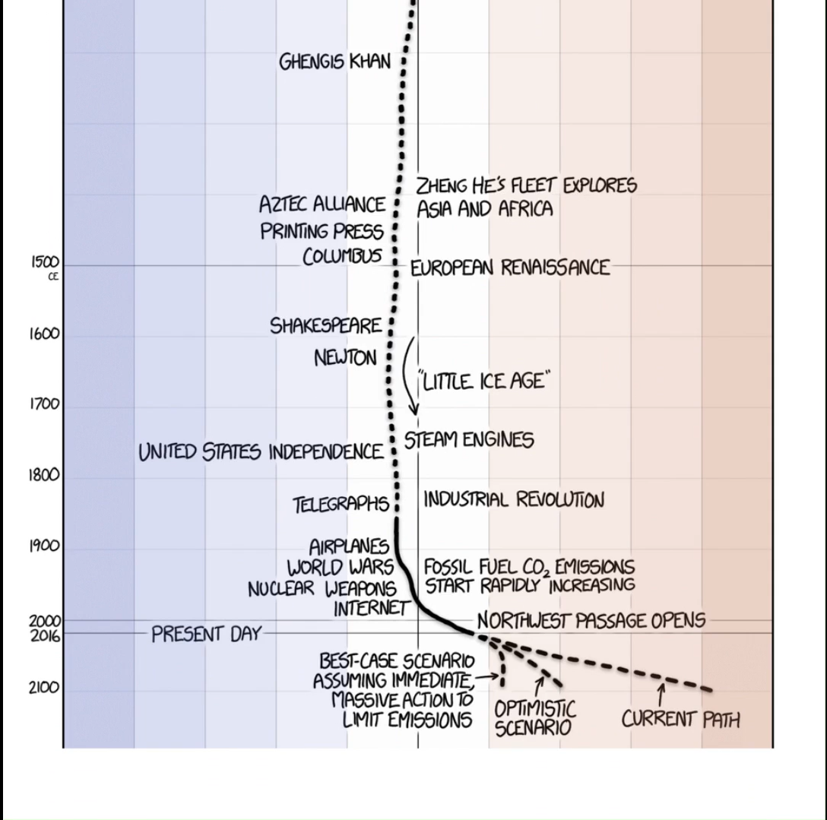
https://xkcd.com/1732/

Slide 5




🖼️ Framework scientifico
📩 Reperire i dati
⚙️ Analizzare/processare i dati
🗺️ Visualizzare i risultati
🤔 Interrogarsi sui risultati

Slide 6

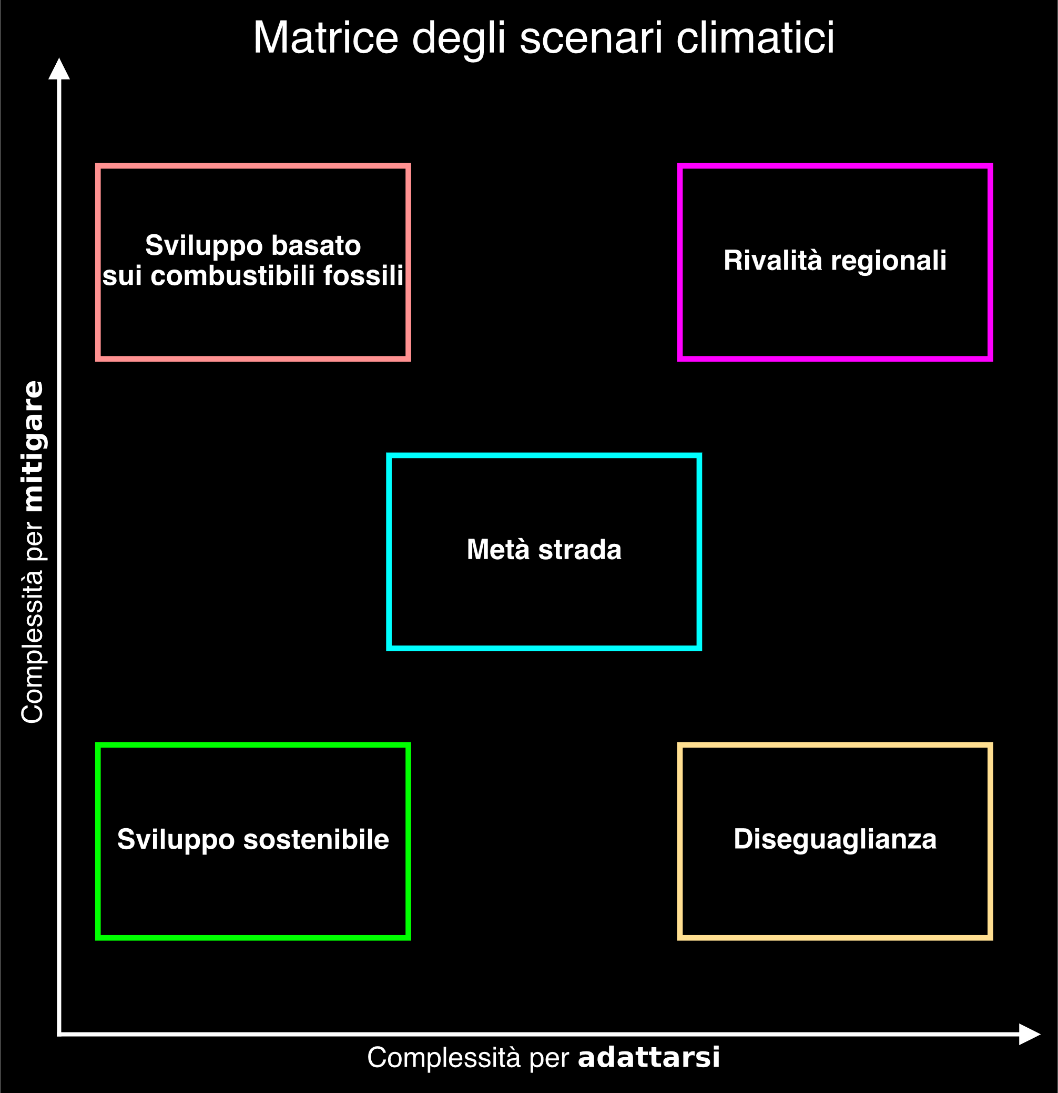

Slide 12

© IIASA and contributing modeling teams 2024

Slide 13
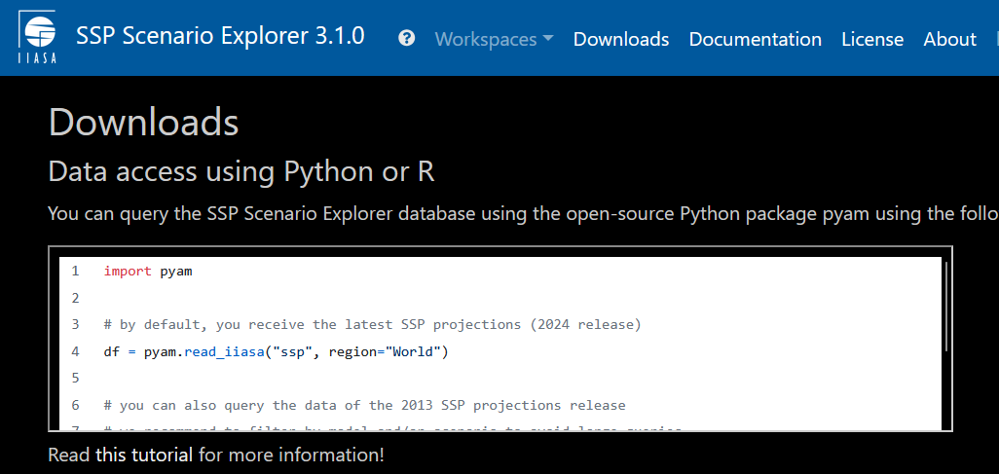
https://data.ece.iiasa.ac.at/ssp/#/downloads
© IIASA and contributing modeling teams 2024

Slide 14
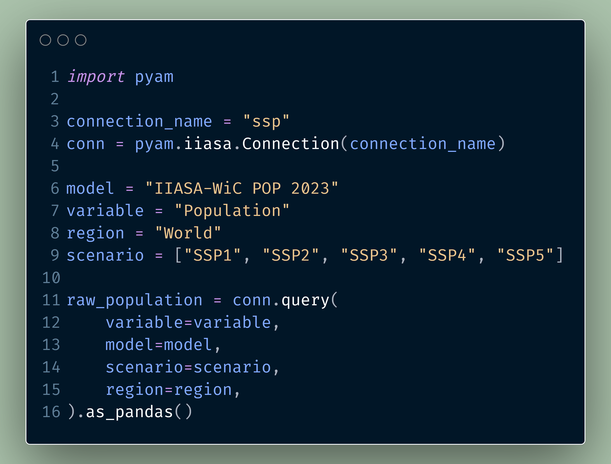

Slide 17
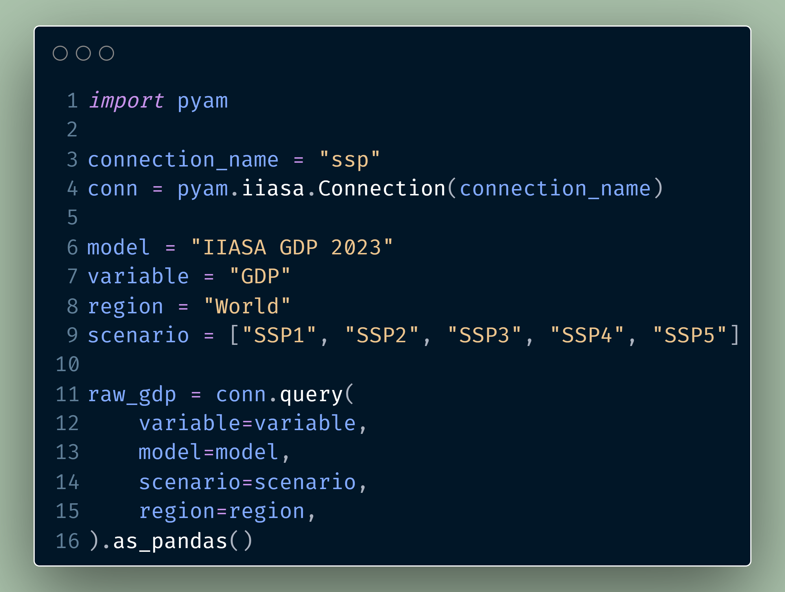

Slide 18
Hannah Ritchie, Pablo Rosado, and Max Roser (2023) - “CO₂ and Greenhouse Gas Emissions” Published online at OurWorldinData.org. Retrieved from: 'https://ourworldindata.org/co2-and-greenhouse-gas-emissions' [Online Resource]

Slide 19
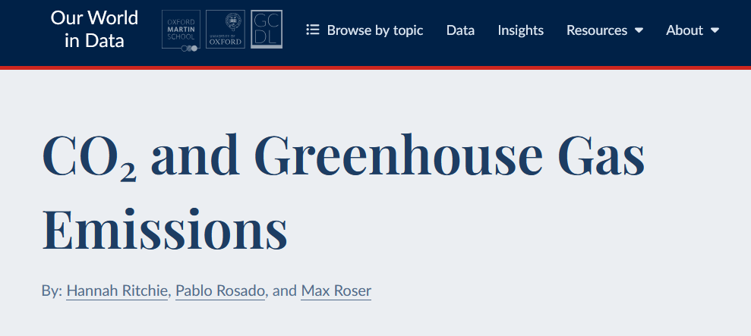
https://github.com/owid/co2-data
Hannah Ritchie, Pablo Rosado, and Max Roser (2023) - “CO₂ and Greenhouse Gas Emissions” Published online at OurWorldinData.org. Retrieved from: 'https://ourworldindata.org/co2-and-greenhouse-gas-emissions' [Online Resource]

Slide 20
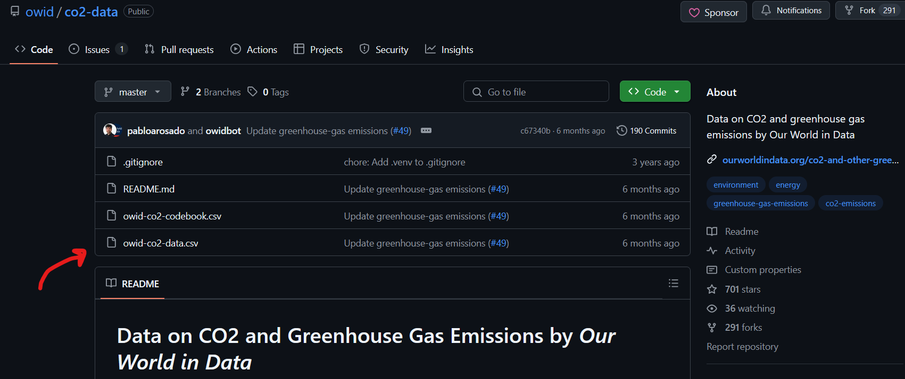
https://github.com/owid/co2-data
Hannah Ritchie, Pablo Rosado, and Max Roser (2023) - “CO₂ and Greenhouse Gas Emissions” Published online at OurWorldinData.org. Retrieved from: 'https://ourworldindata.org/co2-and-greenhouse-gas-emissions' [Online Resource]

Slide 21
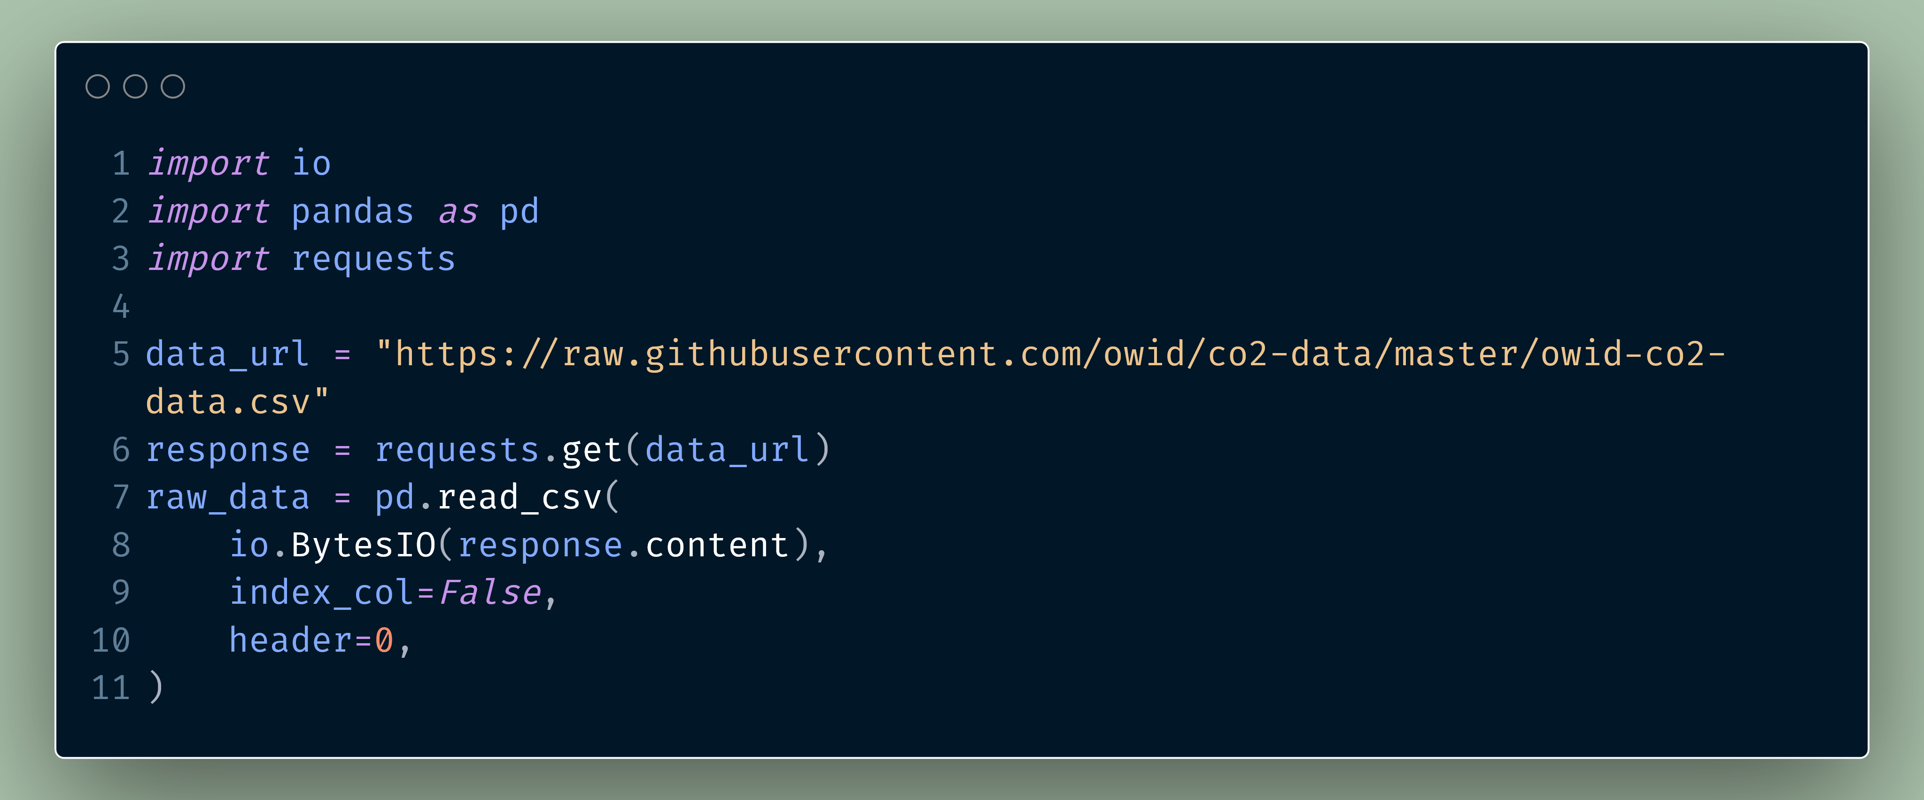

Slide 23


Slide 24


Slide 25
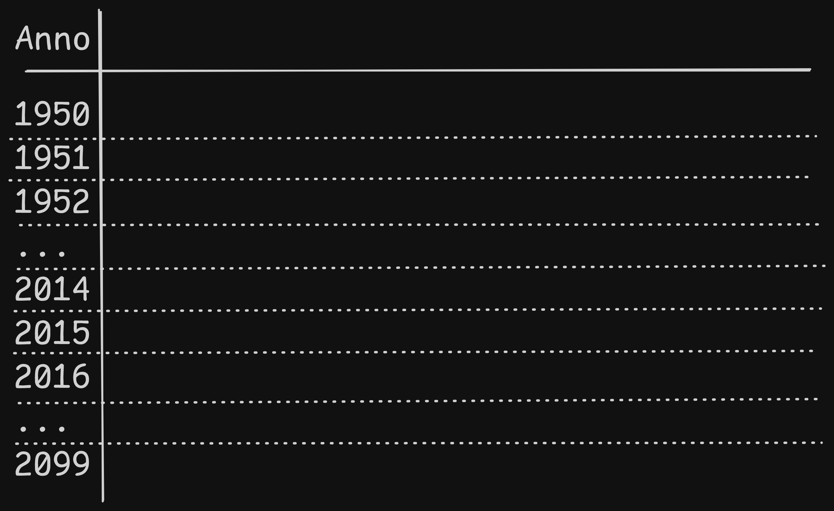

Slide 26
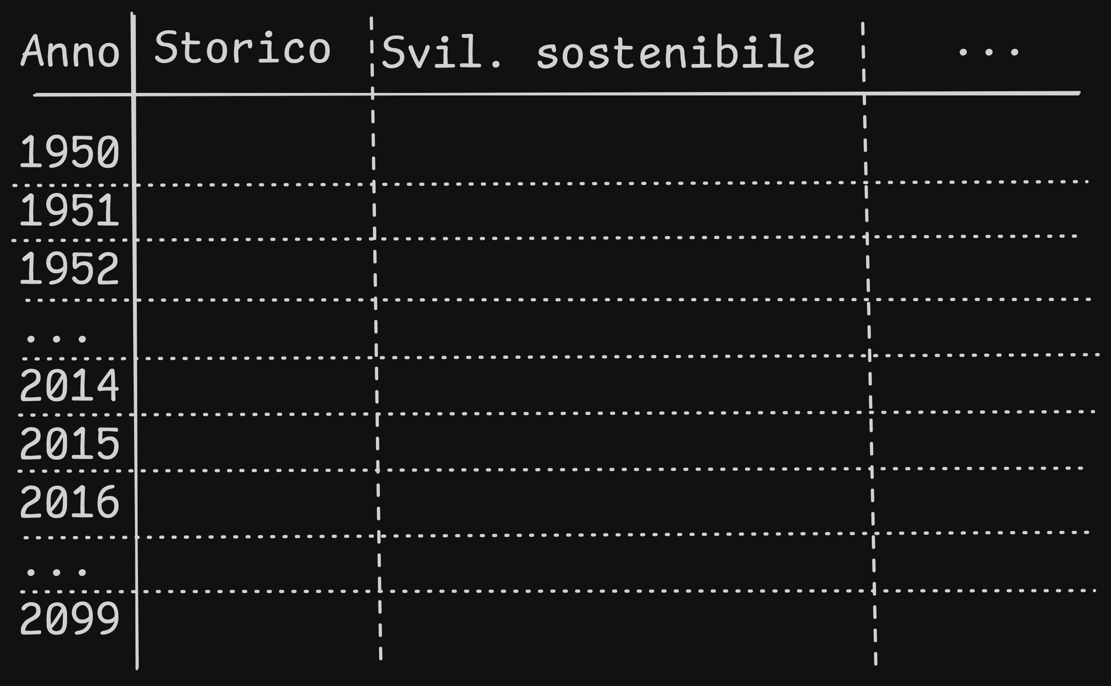

Slide 27
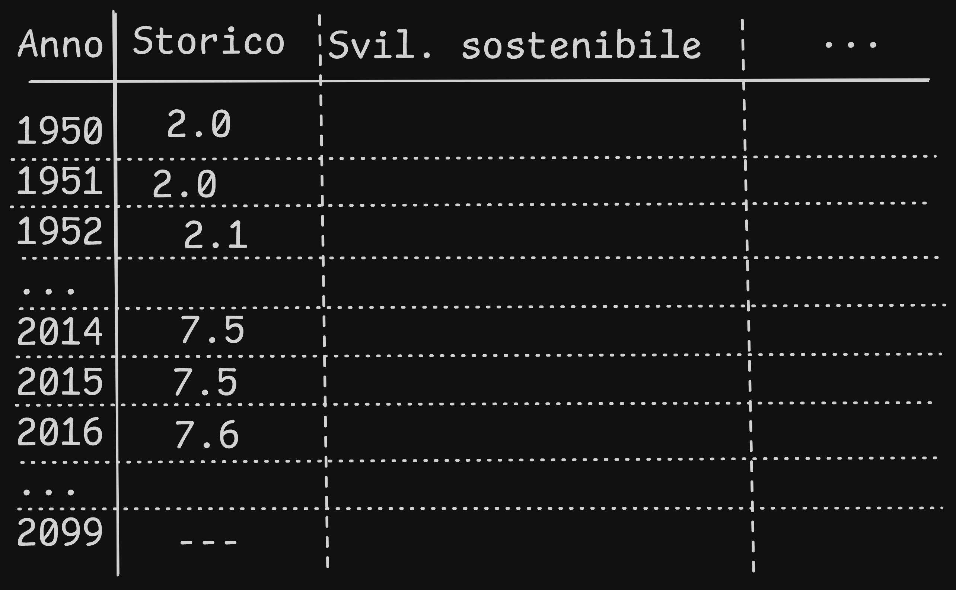

Slide 28


Slide 29
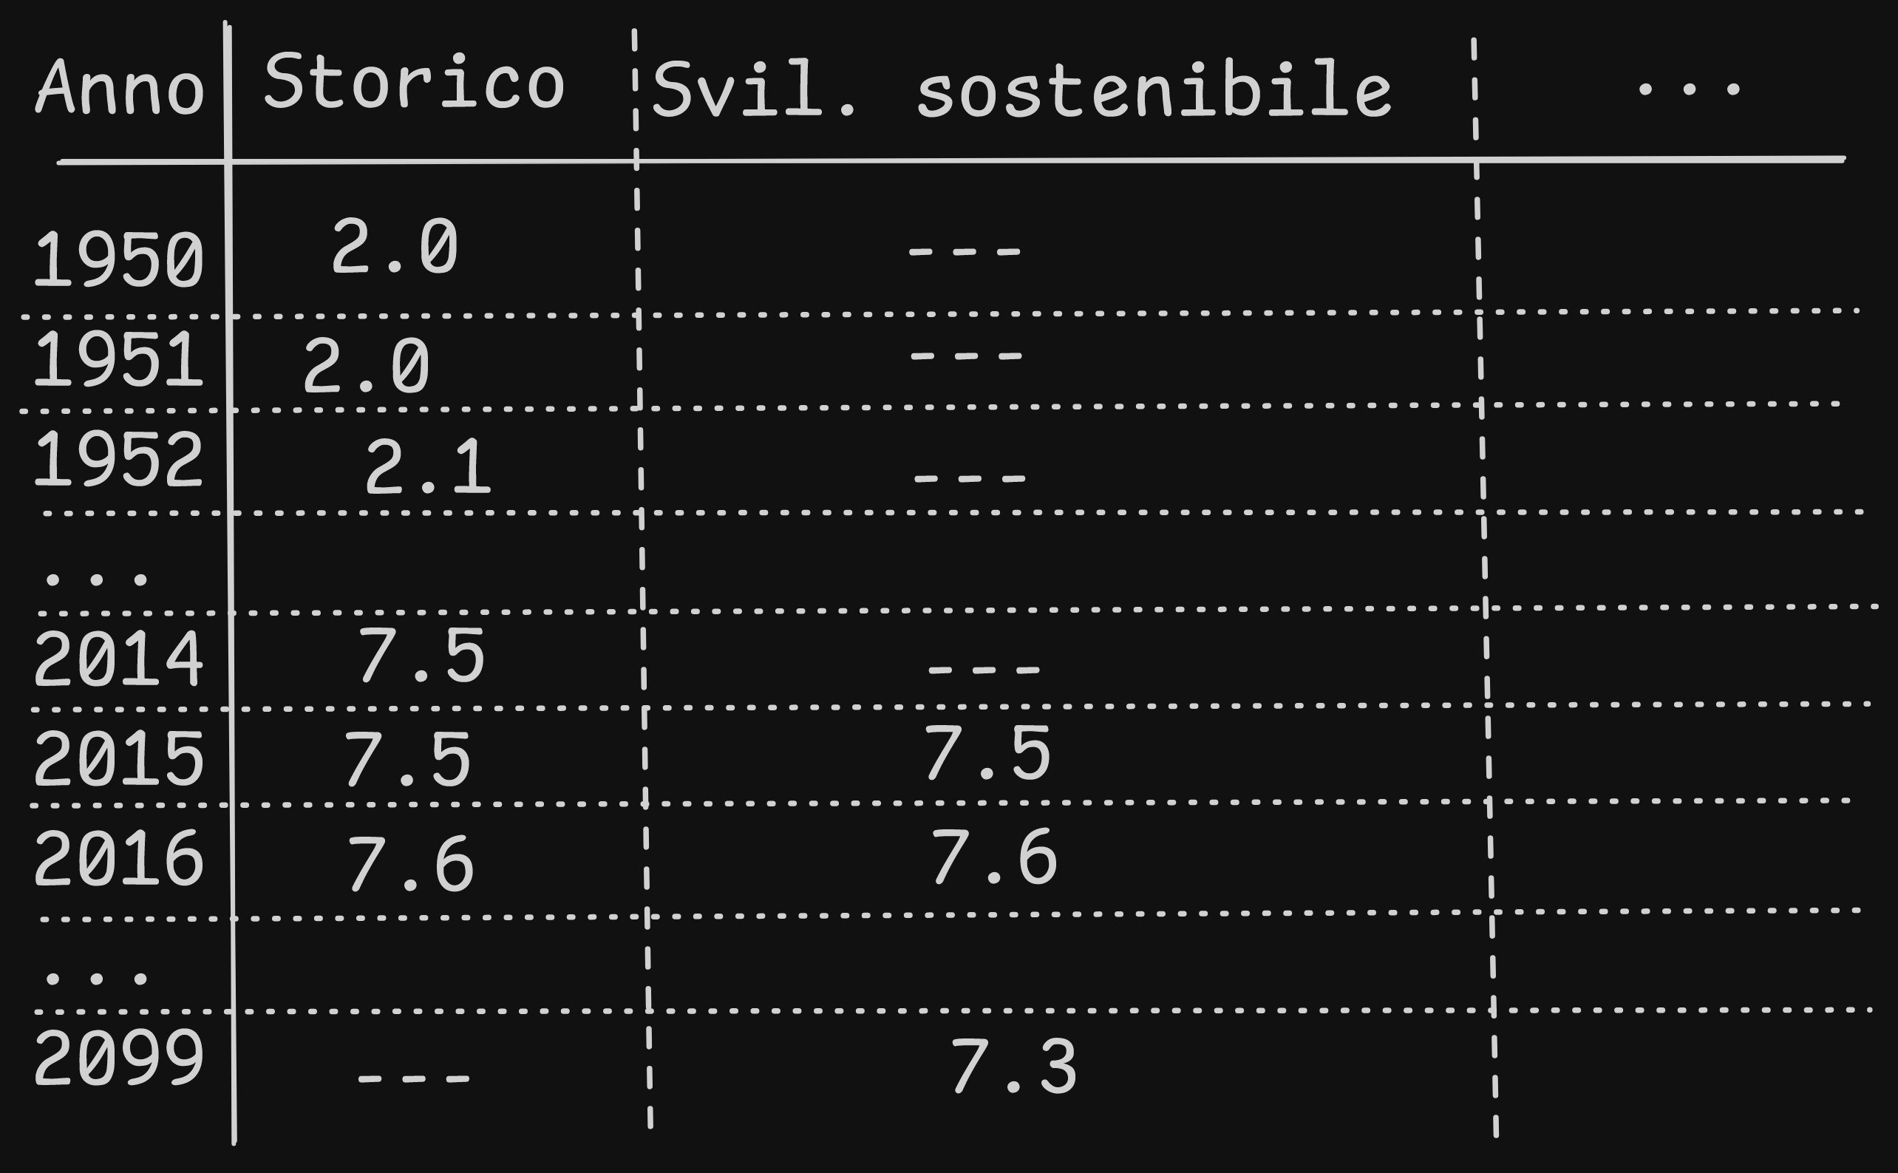

Slide 30
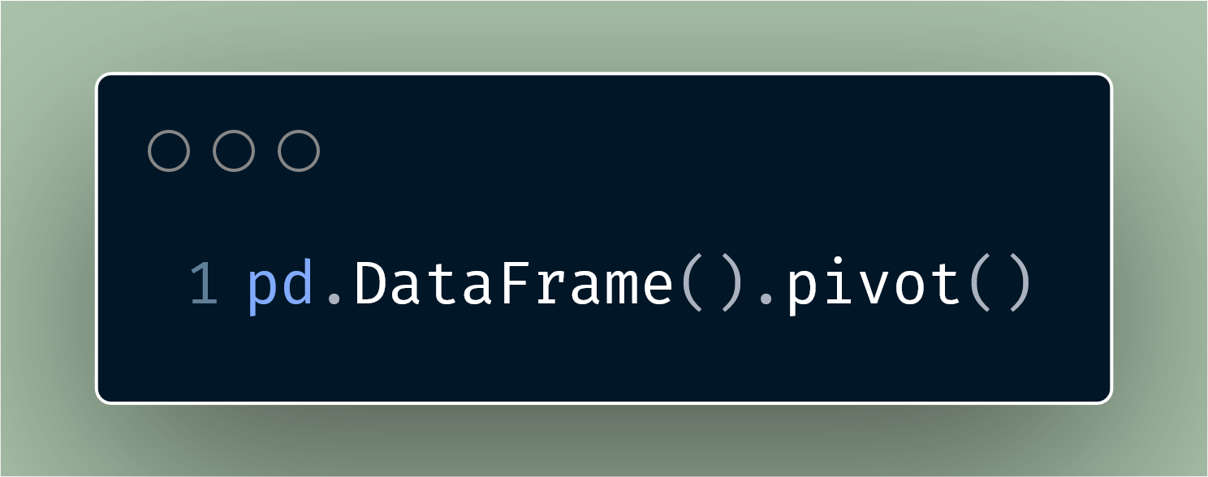

Slide 31
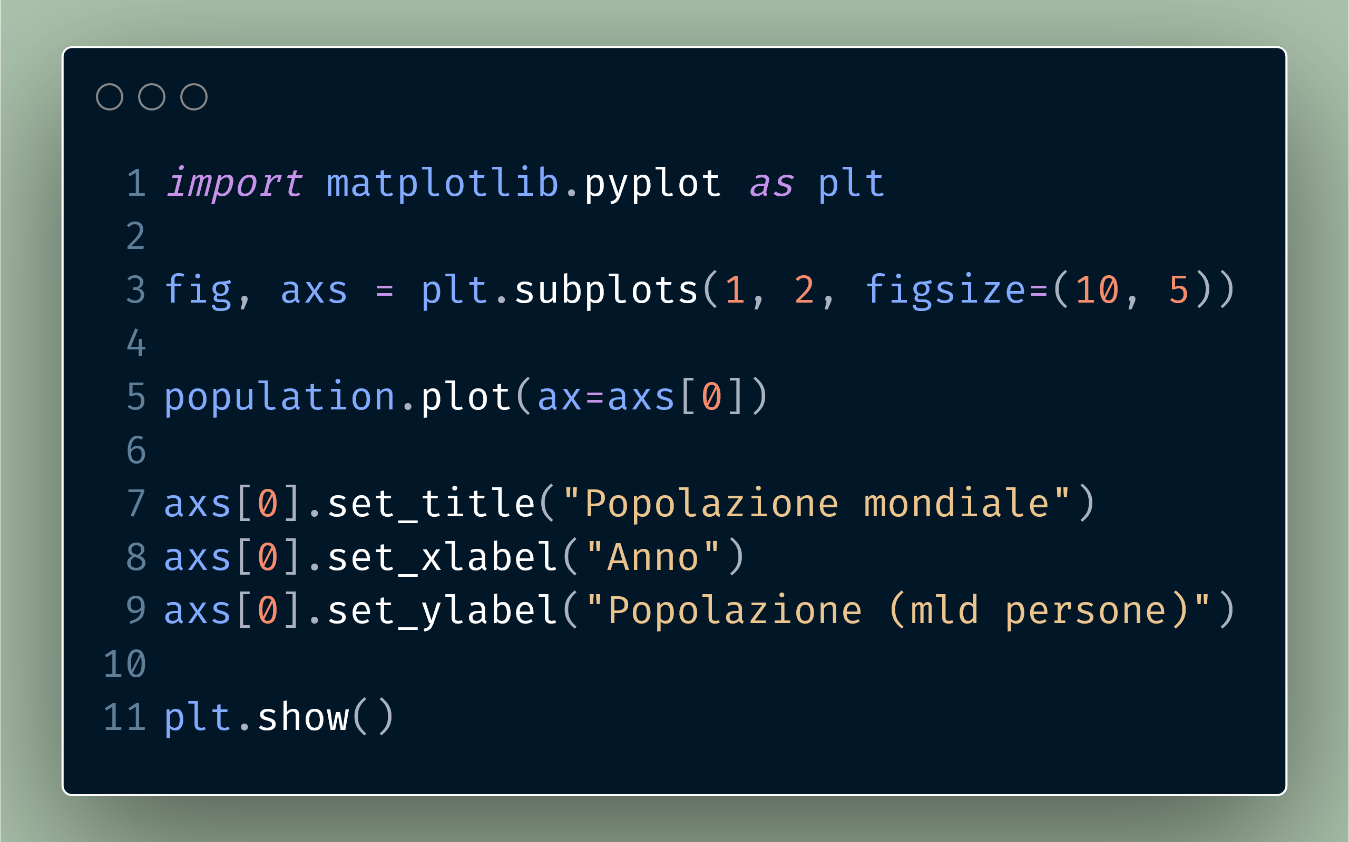
Hannah Ritchie, Pablo Rosado, and Max Roser (2023) - “CO₂ and Greenhouse Gas Emissions” Published online at OurWorldinData.org. Retrieved from: 'https://ourworldindata.org/co2-and-greenhouse-gas-emissions' [Online Resource]
© IIASA and contributing modeling teams 2024
K. Riahi et al.,

Slide 32
Hannah Ritchie, Pablo Rosado, and Max Roser (2023) - “CO₂ and Greenhouse Gas Emissions” Published online at OurWorldinData.org. Retrieved from: 'https://ourworldindata.org/co2-and-greenhouse-gas-emissions' [Online Resource]
© IIASA and contributing modeling teams 2024
K. Riahi et al.,

Slide 33
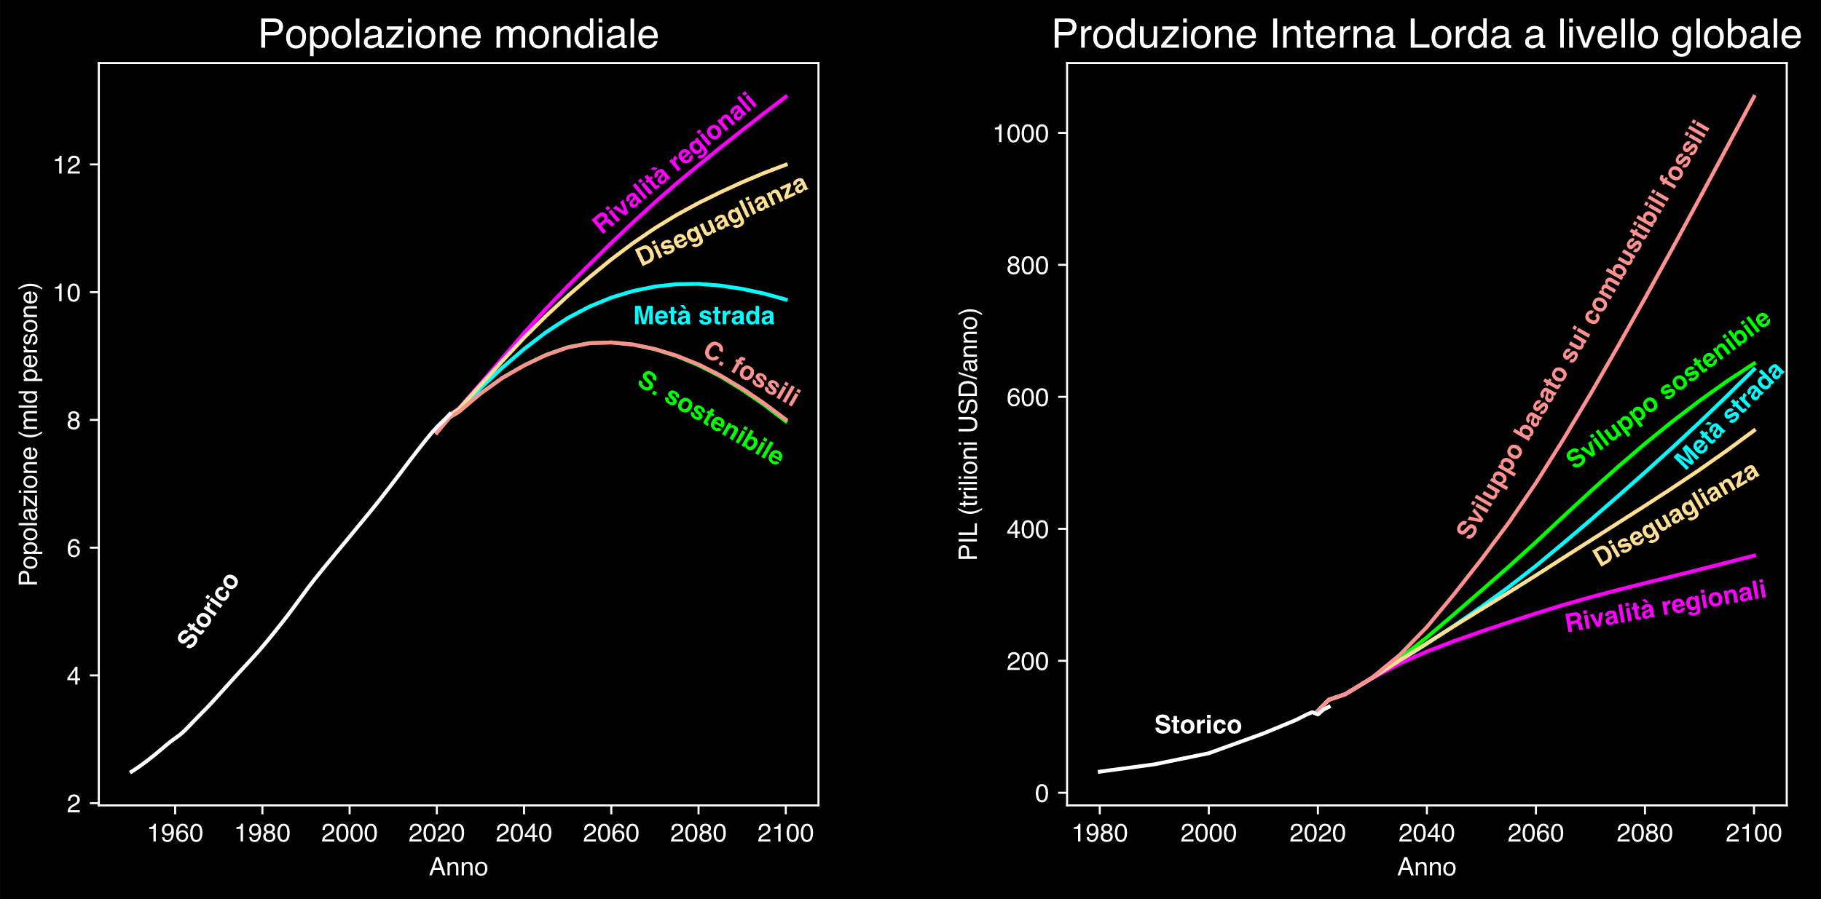
Hannah Ritchie, Pablo Rosado, and Max Roser (2023) - “CO₂ and Greenhouse Gas Emissions” Published online at OurWorldinData.org. Retrieved from: 'https://ourworldindata.org/co2-and-greenhouse-gas-emissions' [Online Resource]
© IIASA and contributing modeling teams 2024
K. Riahi et al.,

Slide 34
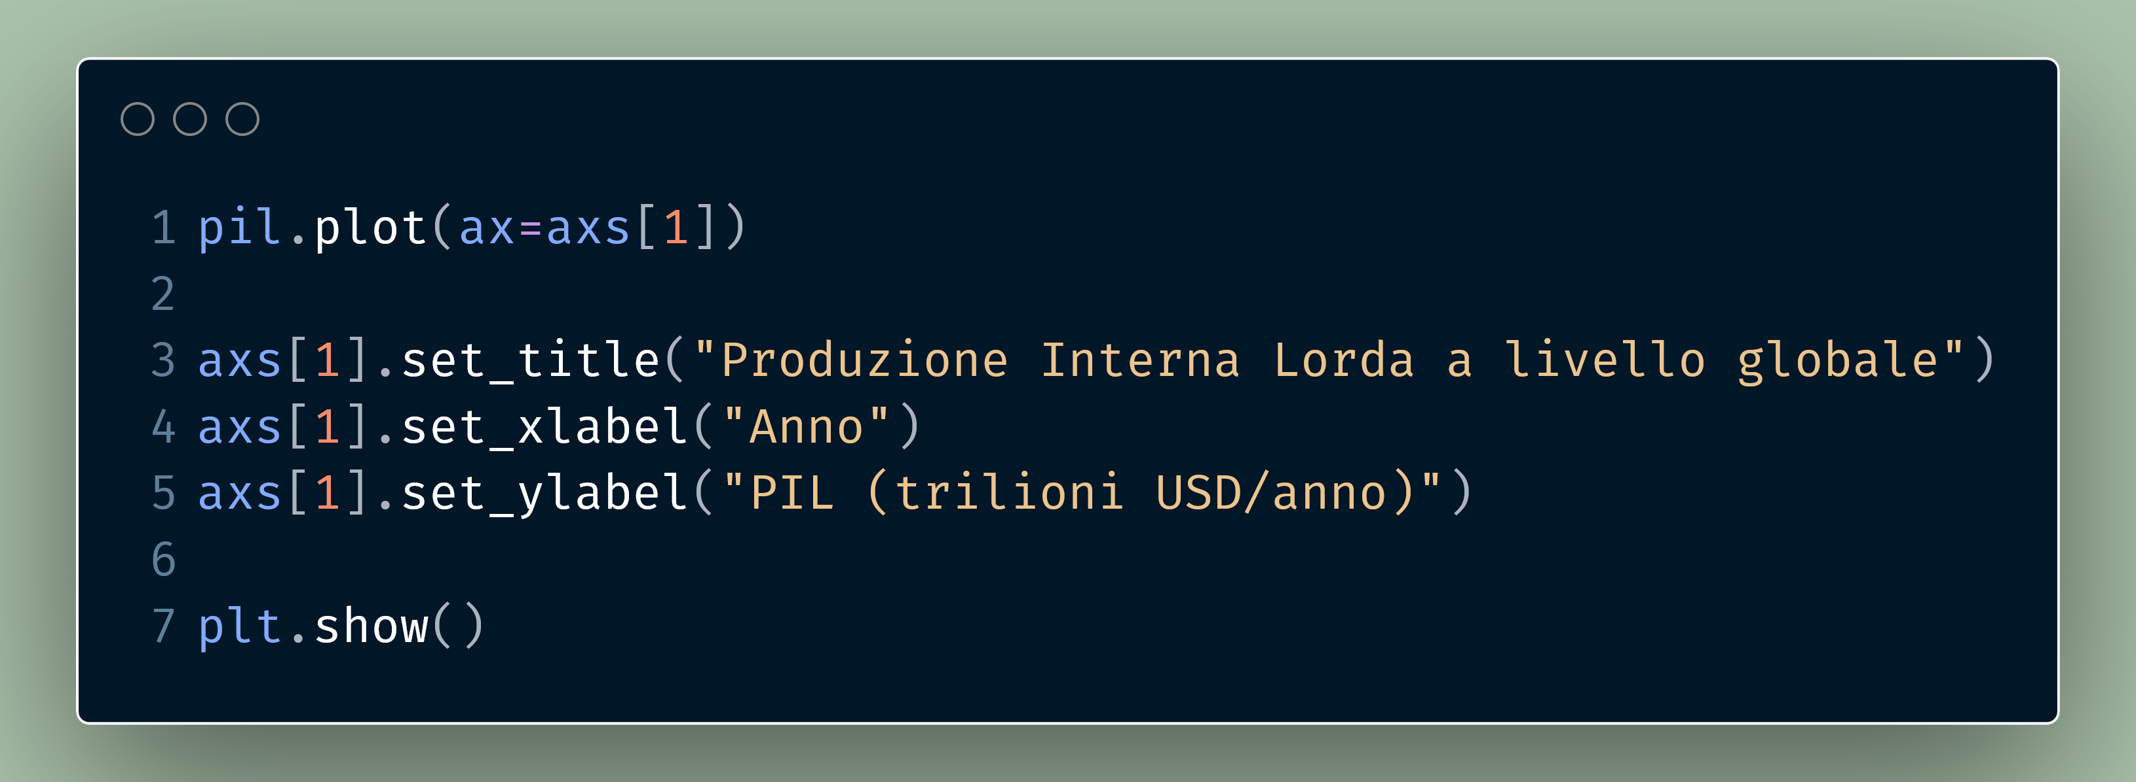
Hannah Ritchie, Pablo Rosado, and Max Roser (2023) - “CO₂ and Greenhouse Gas Emissions” Published online at OurWorldinData.org. Retrieved from: 'https://ourworldindata.org/co2-and-greenhouse-gas-emissions' [Online Resource]
© IIASA and contributing modeling teams 2024
K. Riahi et al.,

Slide 35
Hannah Ritchie, Pablo Rosado, and Max Roser (2023) - “CO₂ and Greenhouse Gas Emissions” Published online at OurWorldinData.org. Retrieved from: 'https://ourworldindata.org/co2-and-greenhouse-gas-emissions' [Online Resource]
© IIASA and contributing modeling teams 2024
K. Riahi et al.,

Slide 36
Hannah Ritchie, Pablo Rosado, and Max Roser (2023) - “CO₂ and Greenhouse Gas Emissions” Published online at OurWorldinData.org. Retrieved from: 'https://ourworldindata.org/co2-and-greenhouse-gas-emissions' [Online Resource]
© IIASA and contributing modeling teams 2024
K. Riahi et al.,

Slide 37
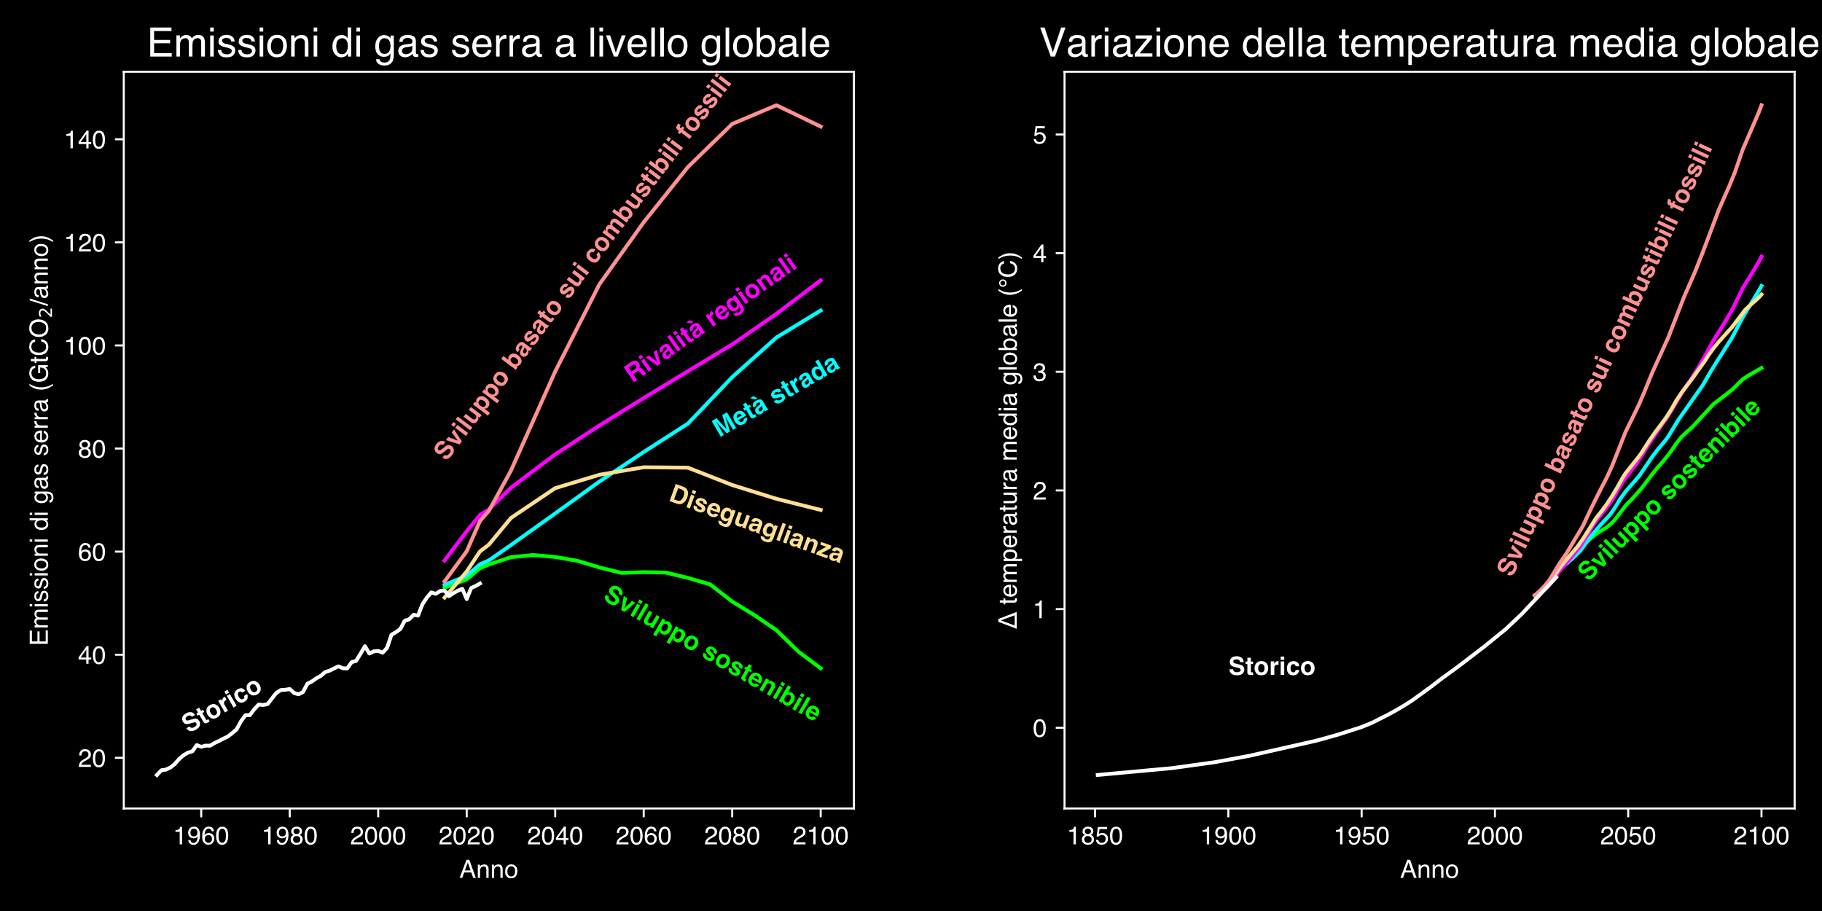
Hannah Ritchie, Pablo Rosado, and Max Roser (2023) - “CO₂ and Greenhouse Gas Emissions” Published online at OurWorldinData.org. Retrieved from: 'https://ourworldindata.org/co2-and-greenhouse-gas-emissions' [Online Resource]
© IIASA and contributing modeling teams 2024
K. Riahi et al.,

Slide 38
Hannah Ritchie, Pablo Rosado, and Max Roser (2023) - “CO₂ and Greenhouse Gas Emissions” Published online at OurWorldinData.org. Retrieved from: 'https://ourworldindata.org/co2-and-greenhouse-gas-emissions' [Online Resource]
© IIASA and contributing modeling teams 2024
K. Riahi et al.,

Slide 39
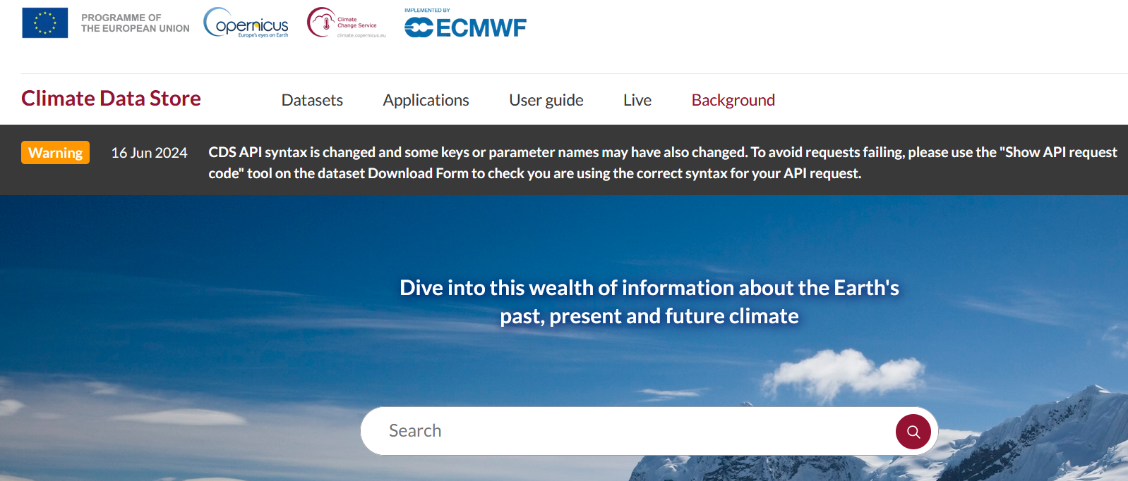
https://cds.climate.copernicus.eu/

Slide 40
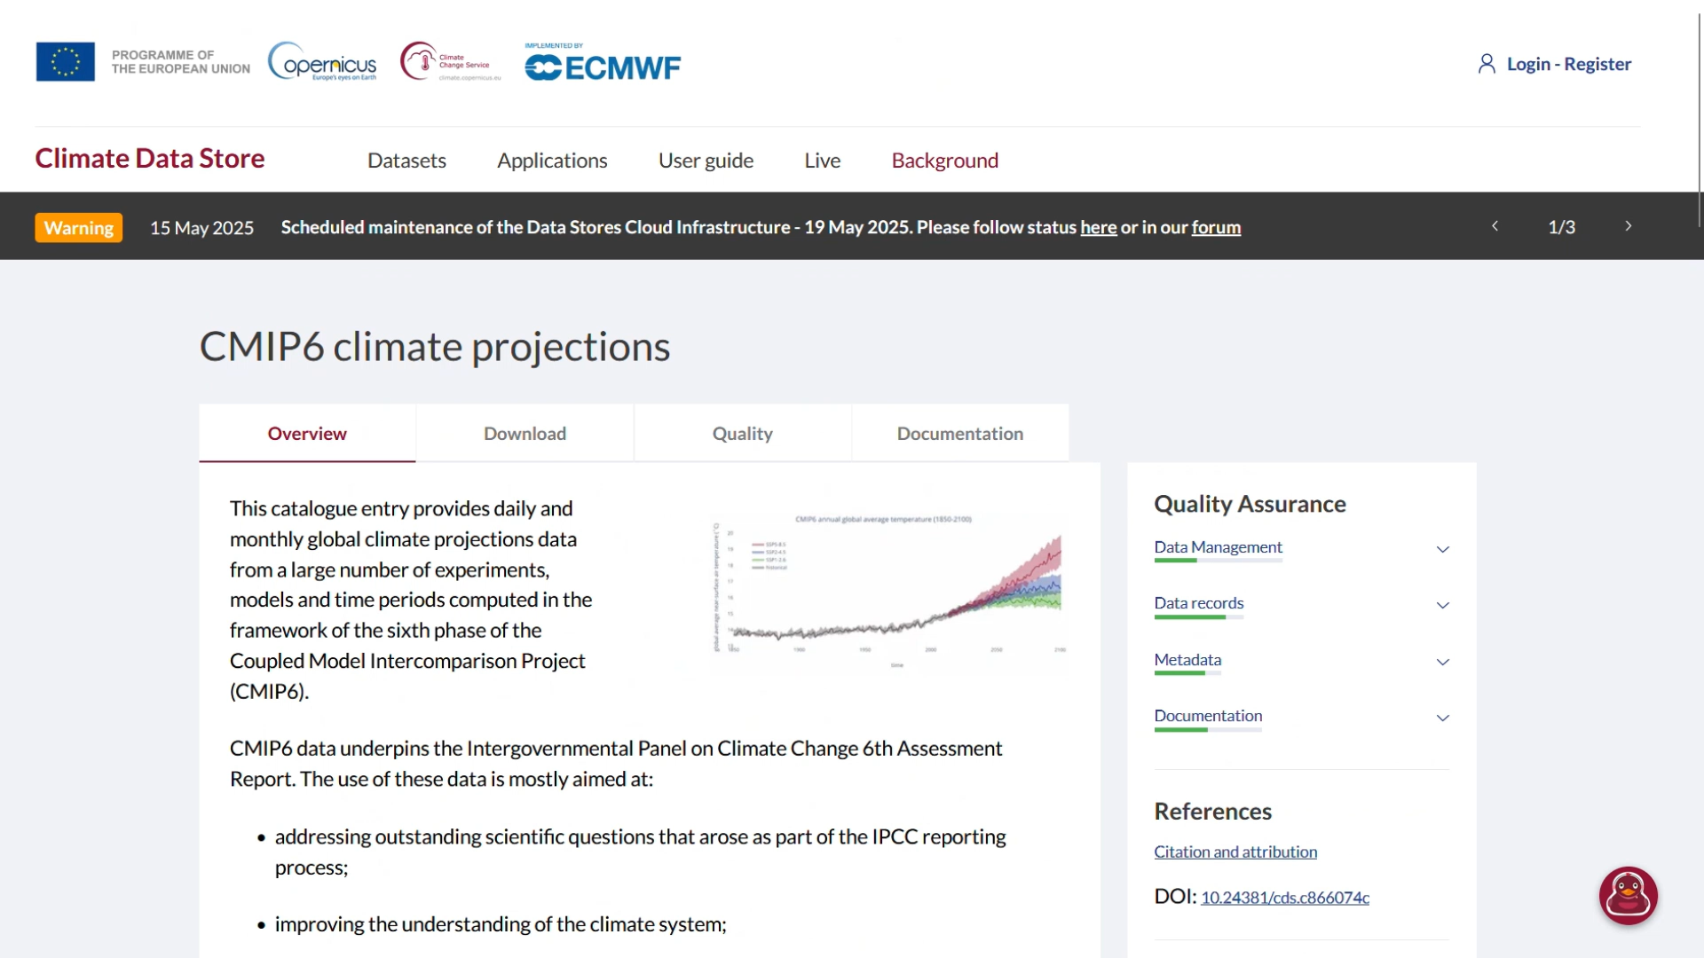

Slide 41
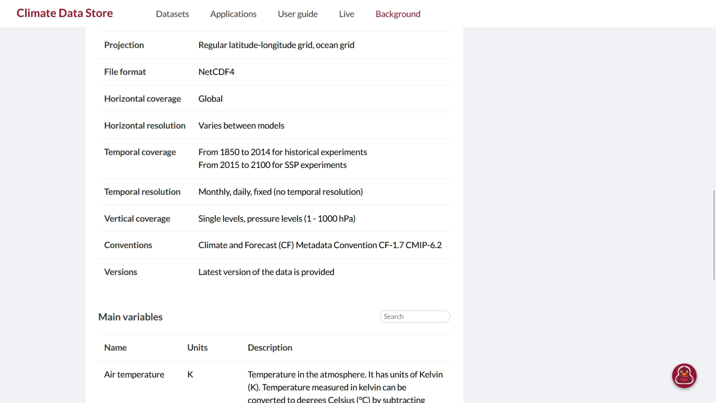

Slide 42
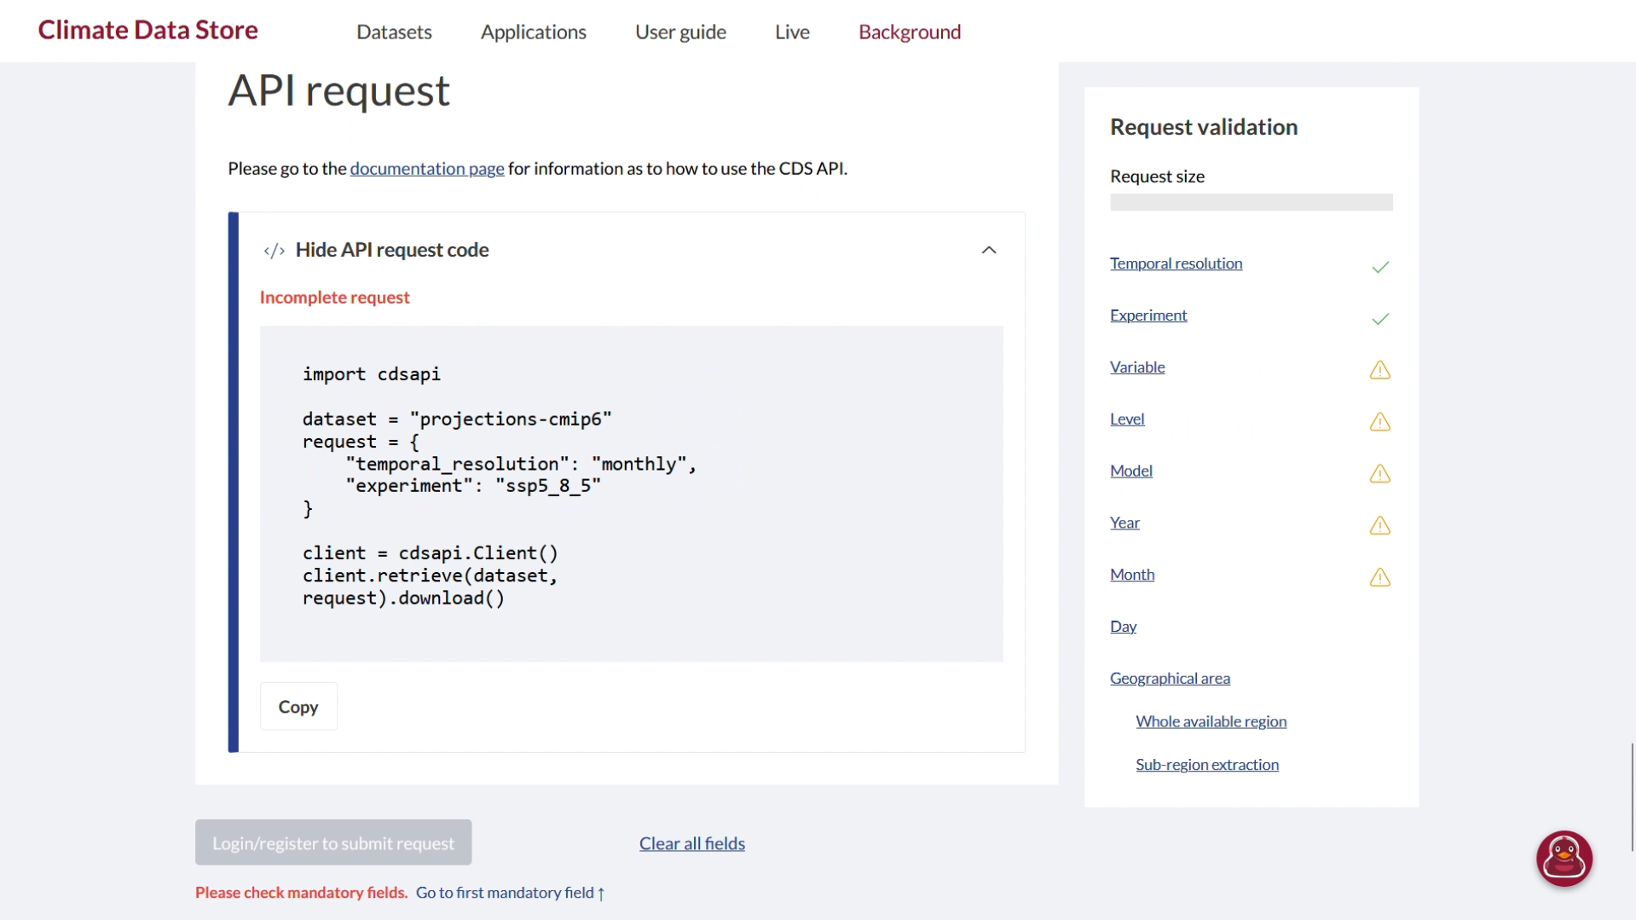

Slide 43
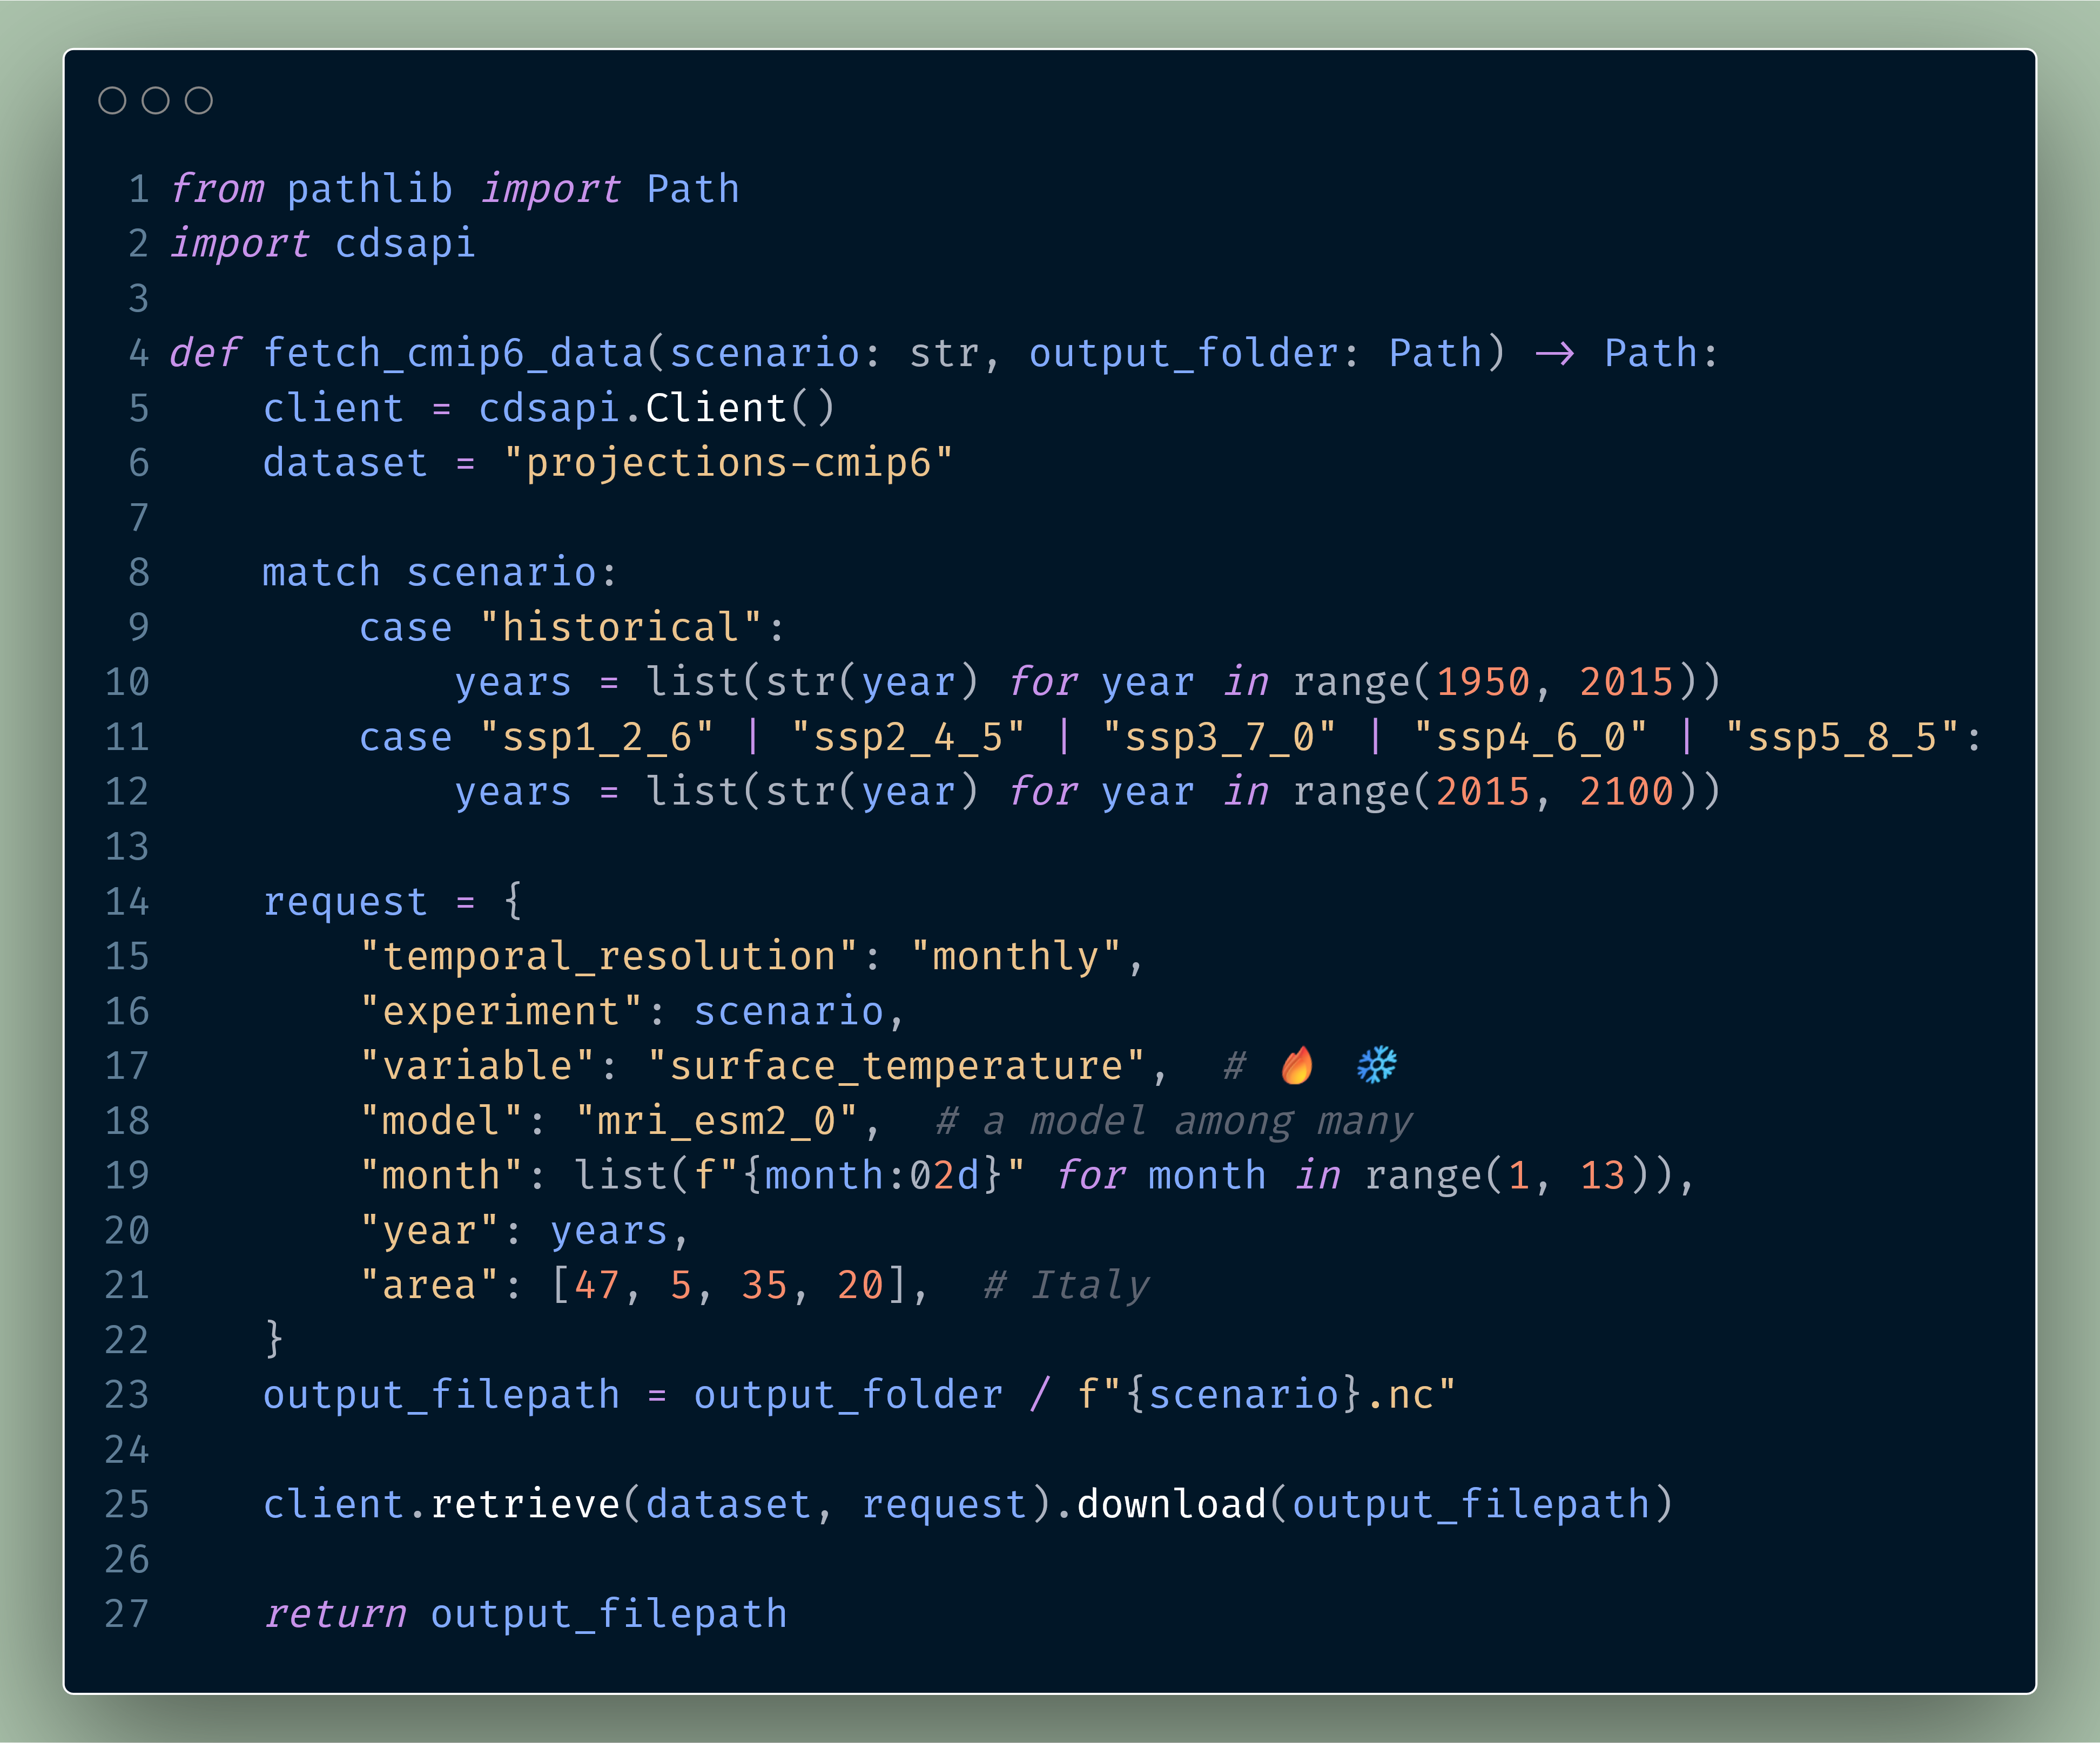

Slide 47
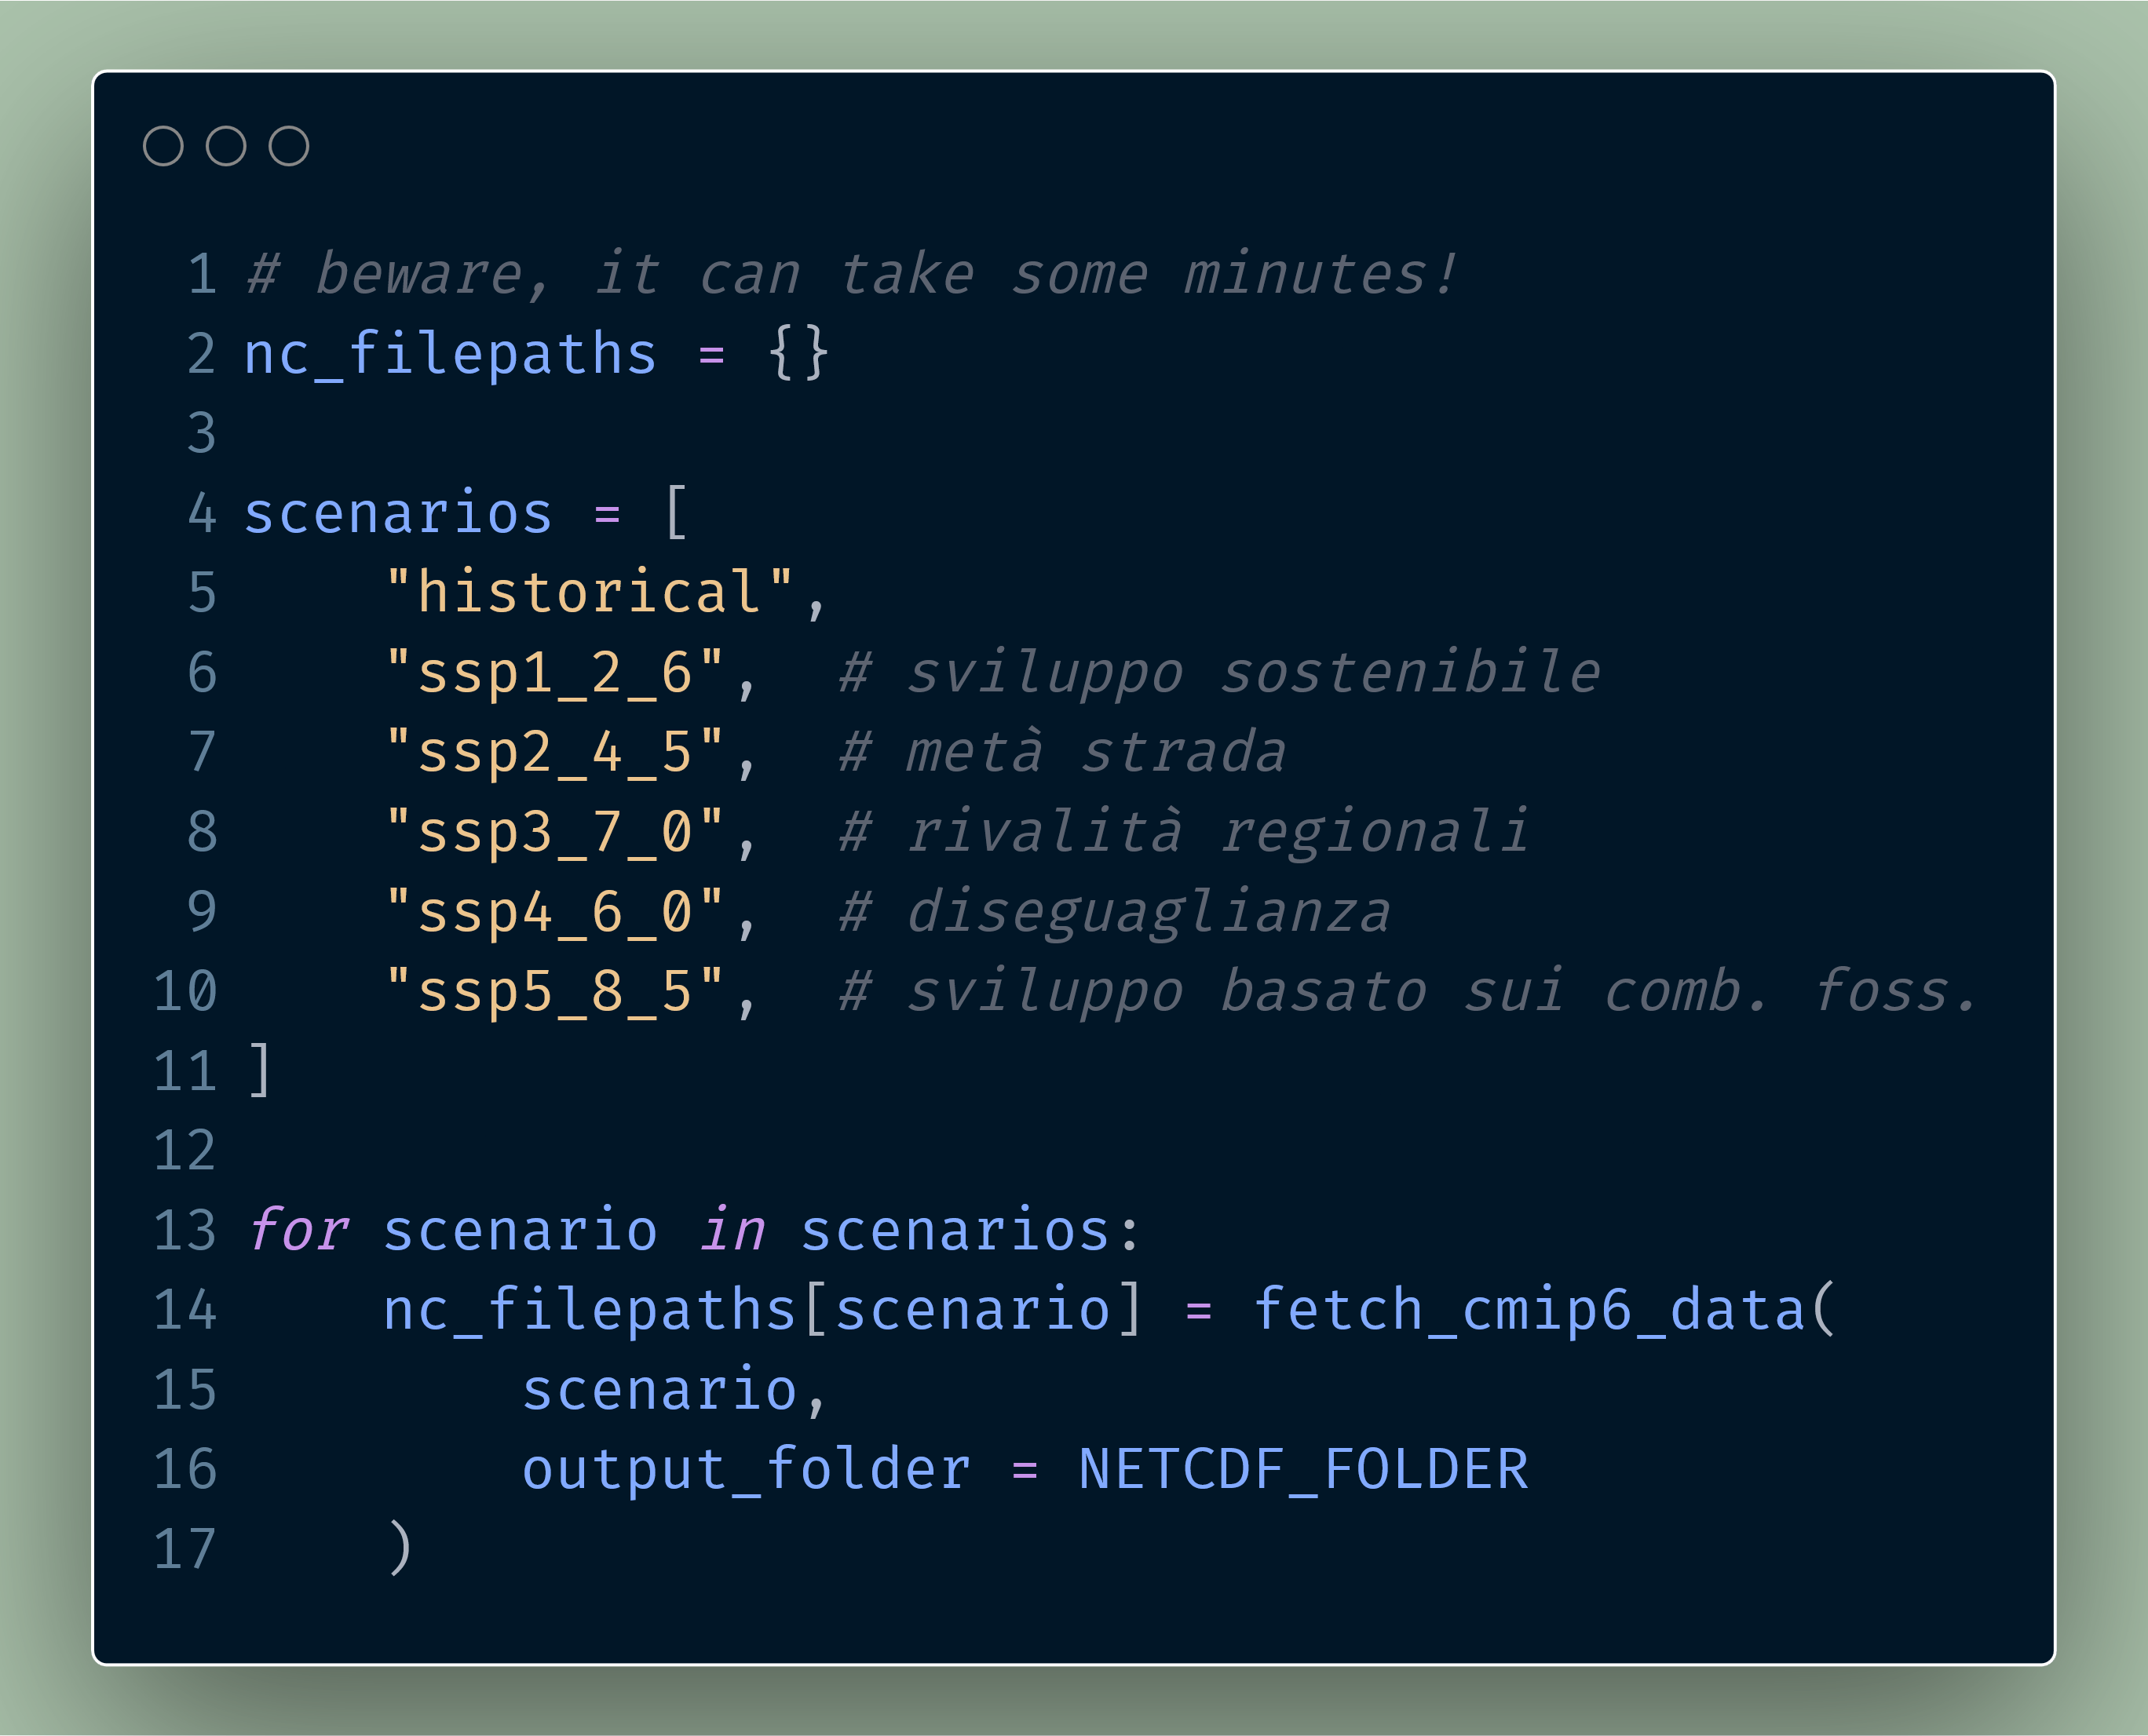

Slide 48
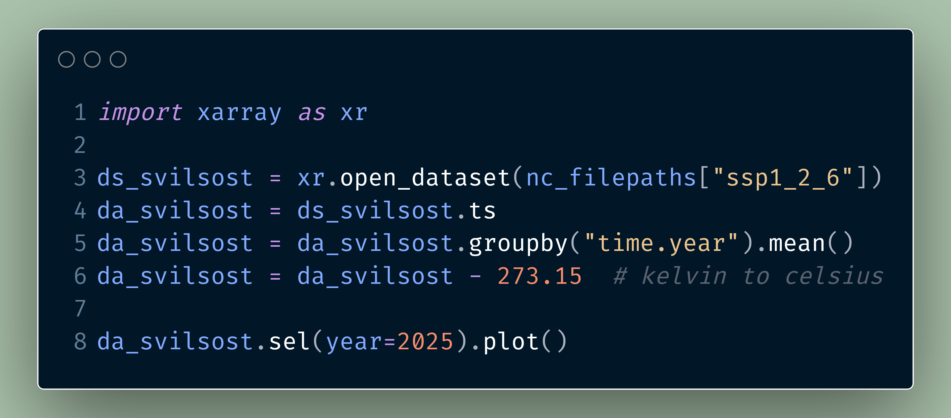

Slide 49
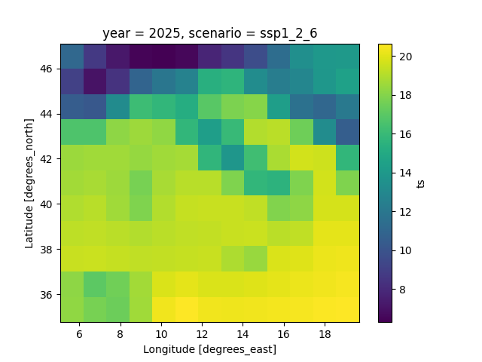

Slide 50
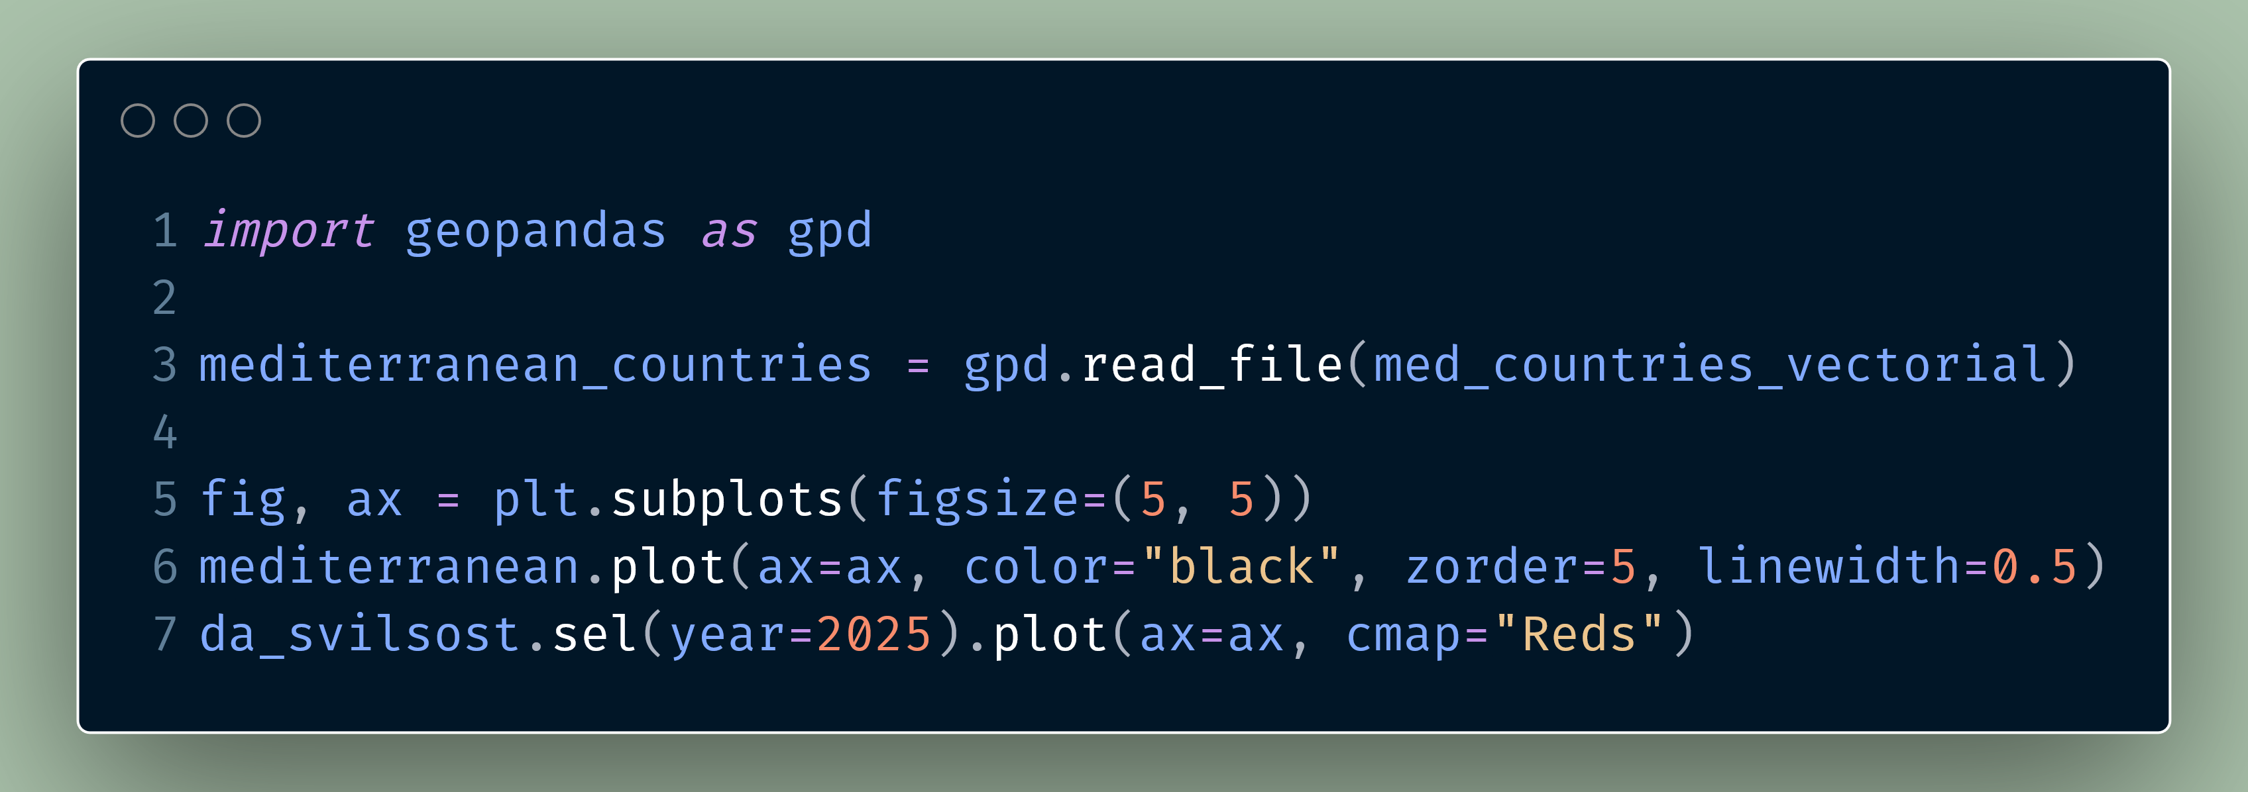

Slide 51
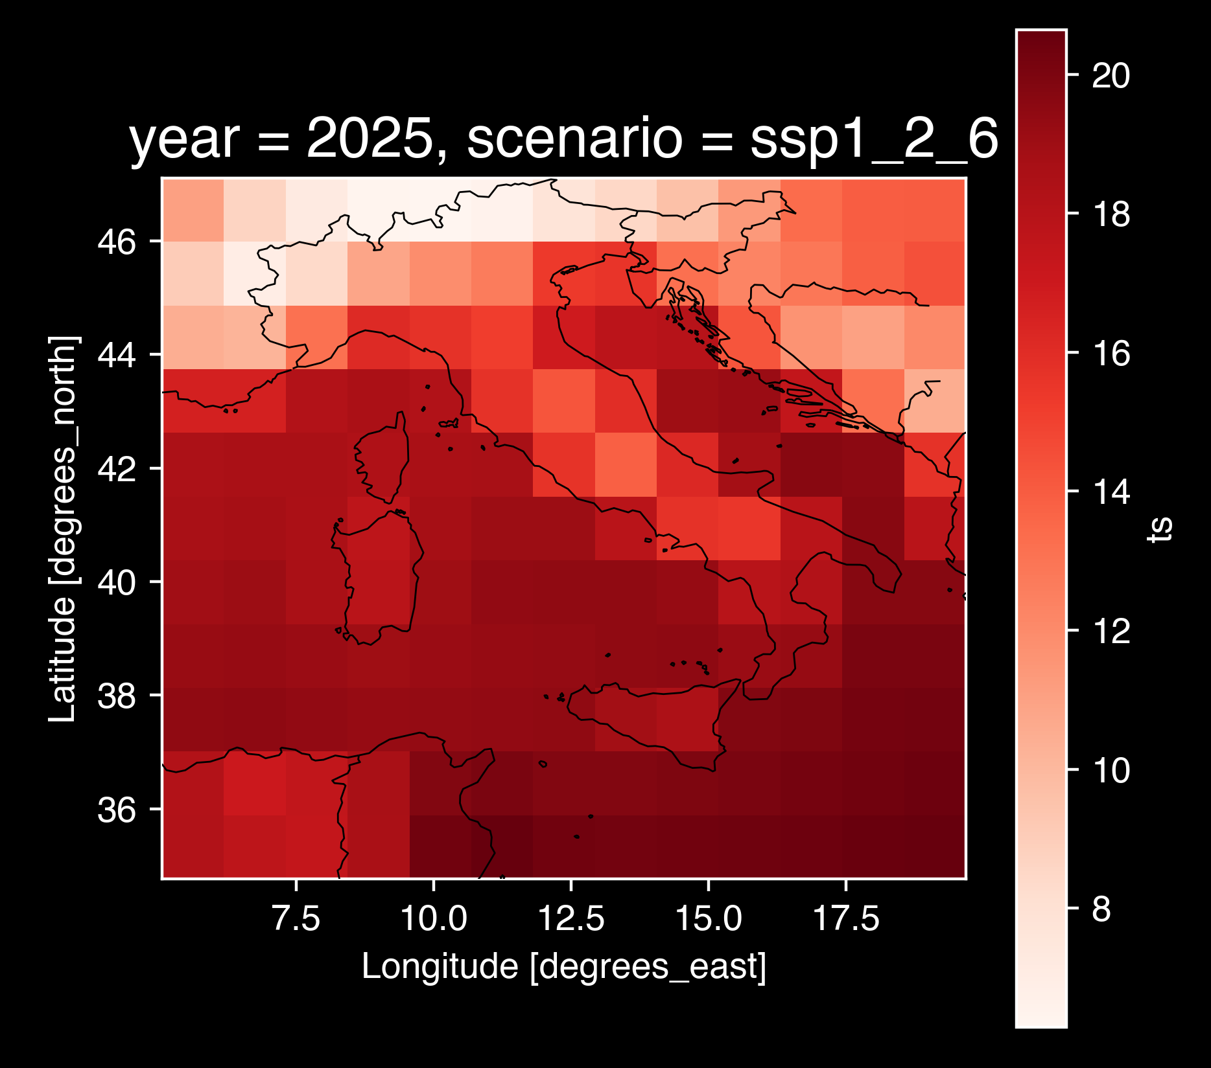

Slide 52
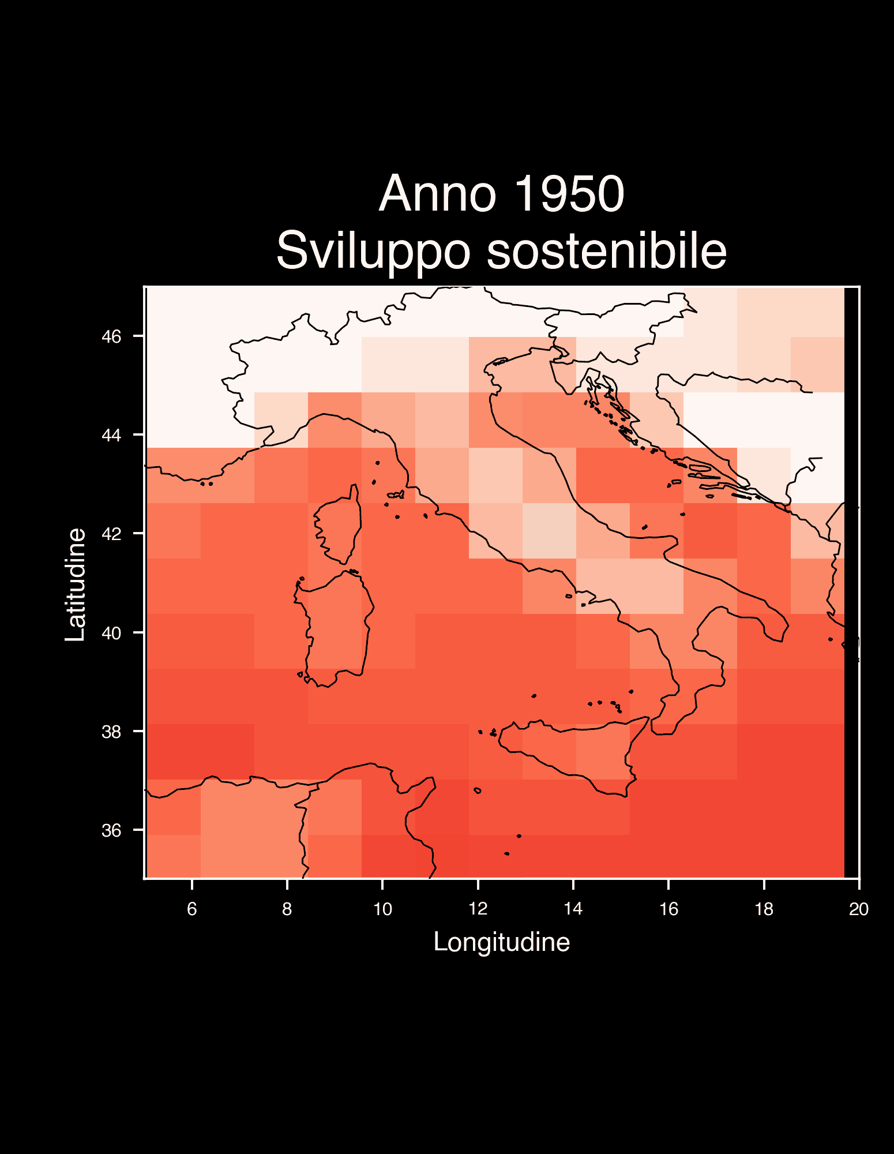
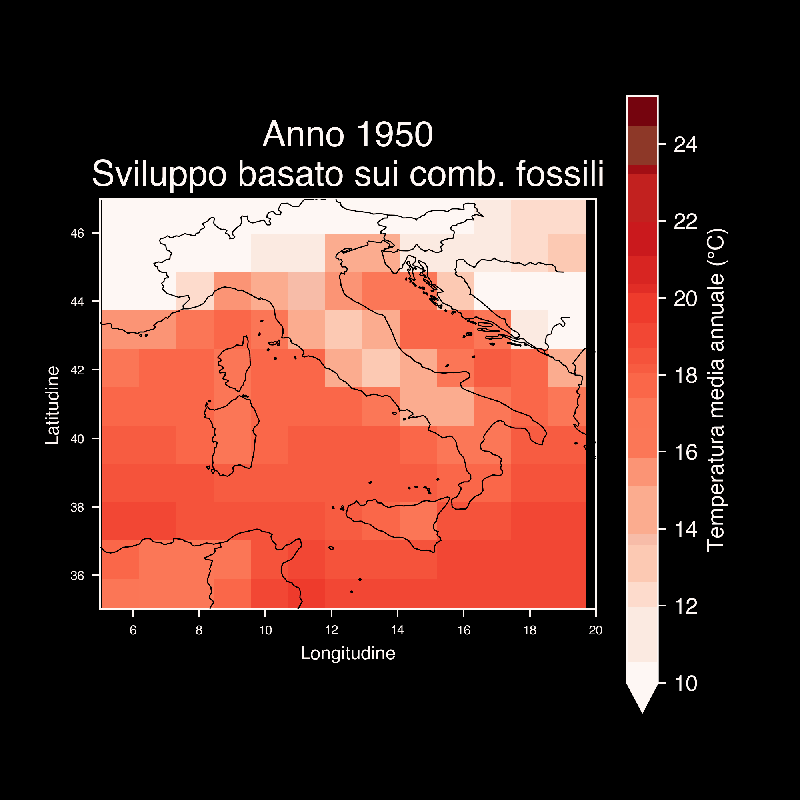

Slide 53
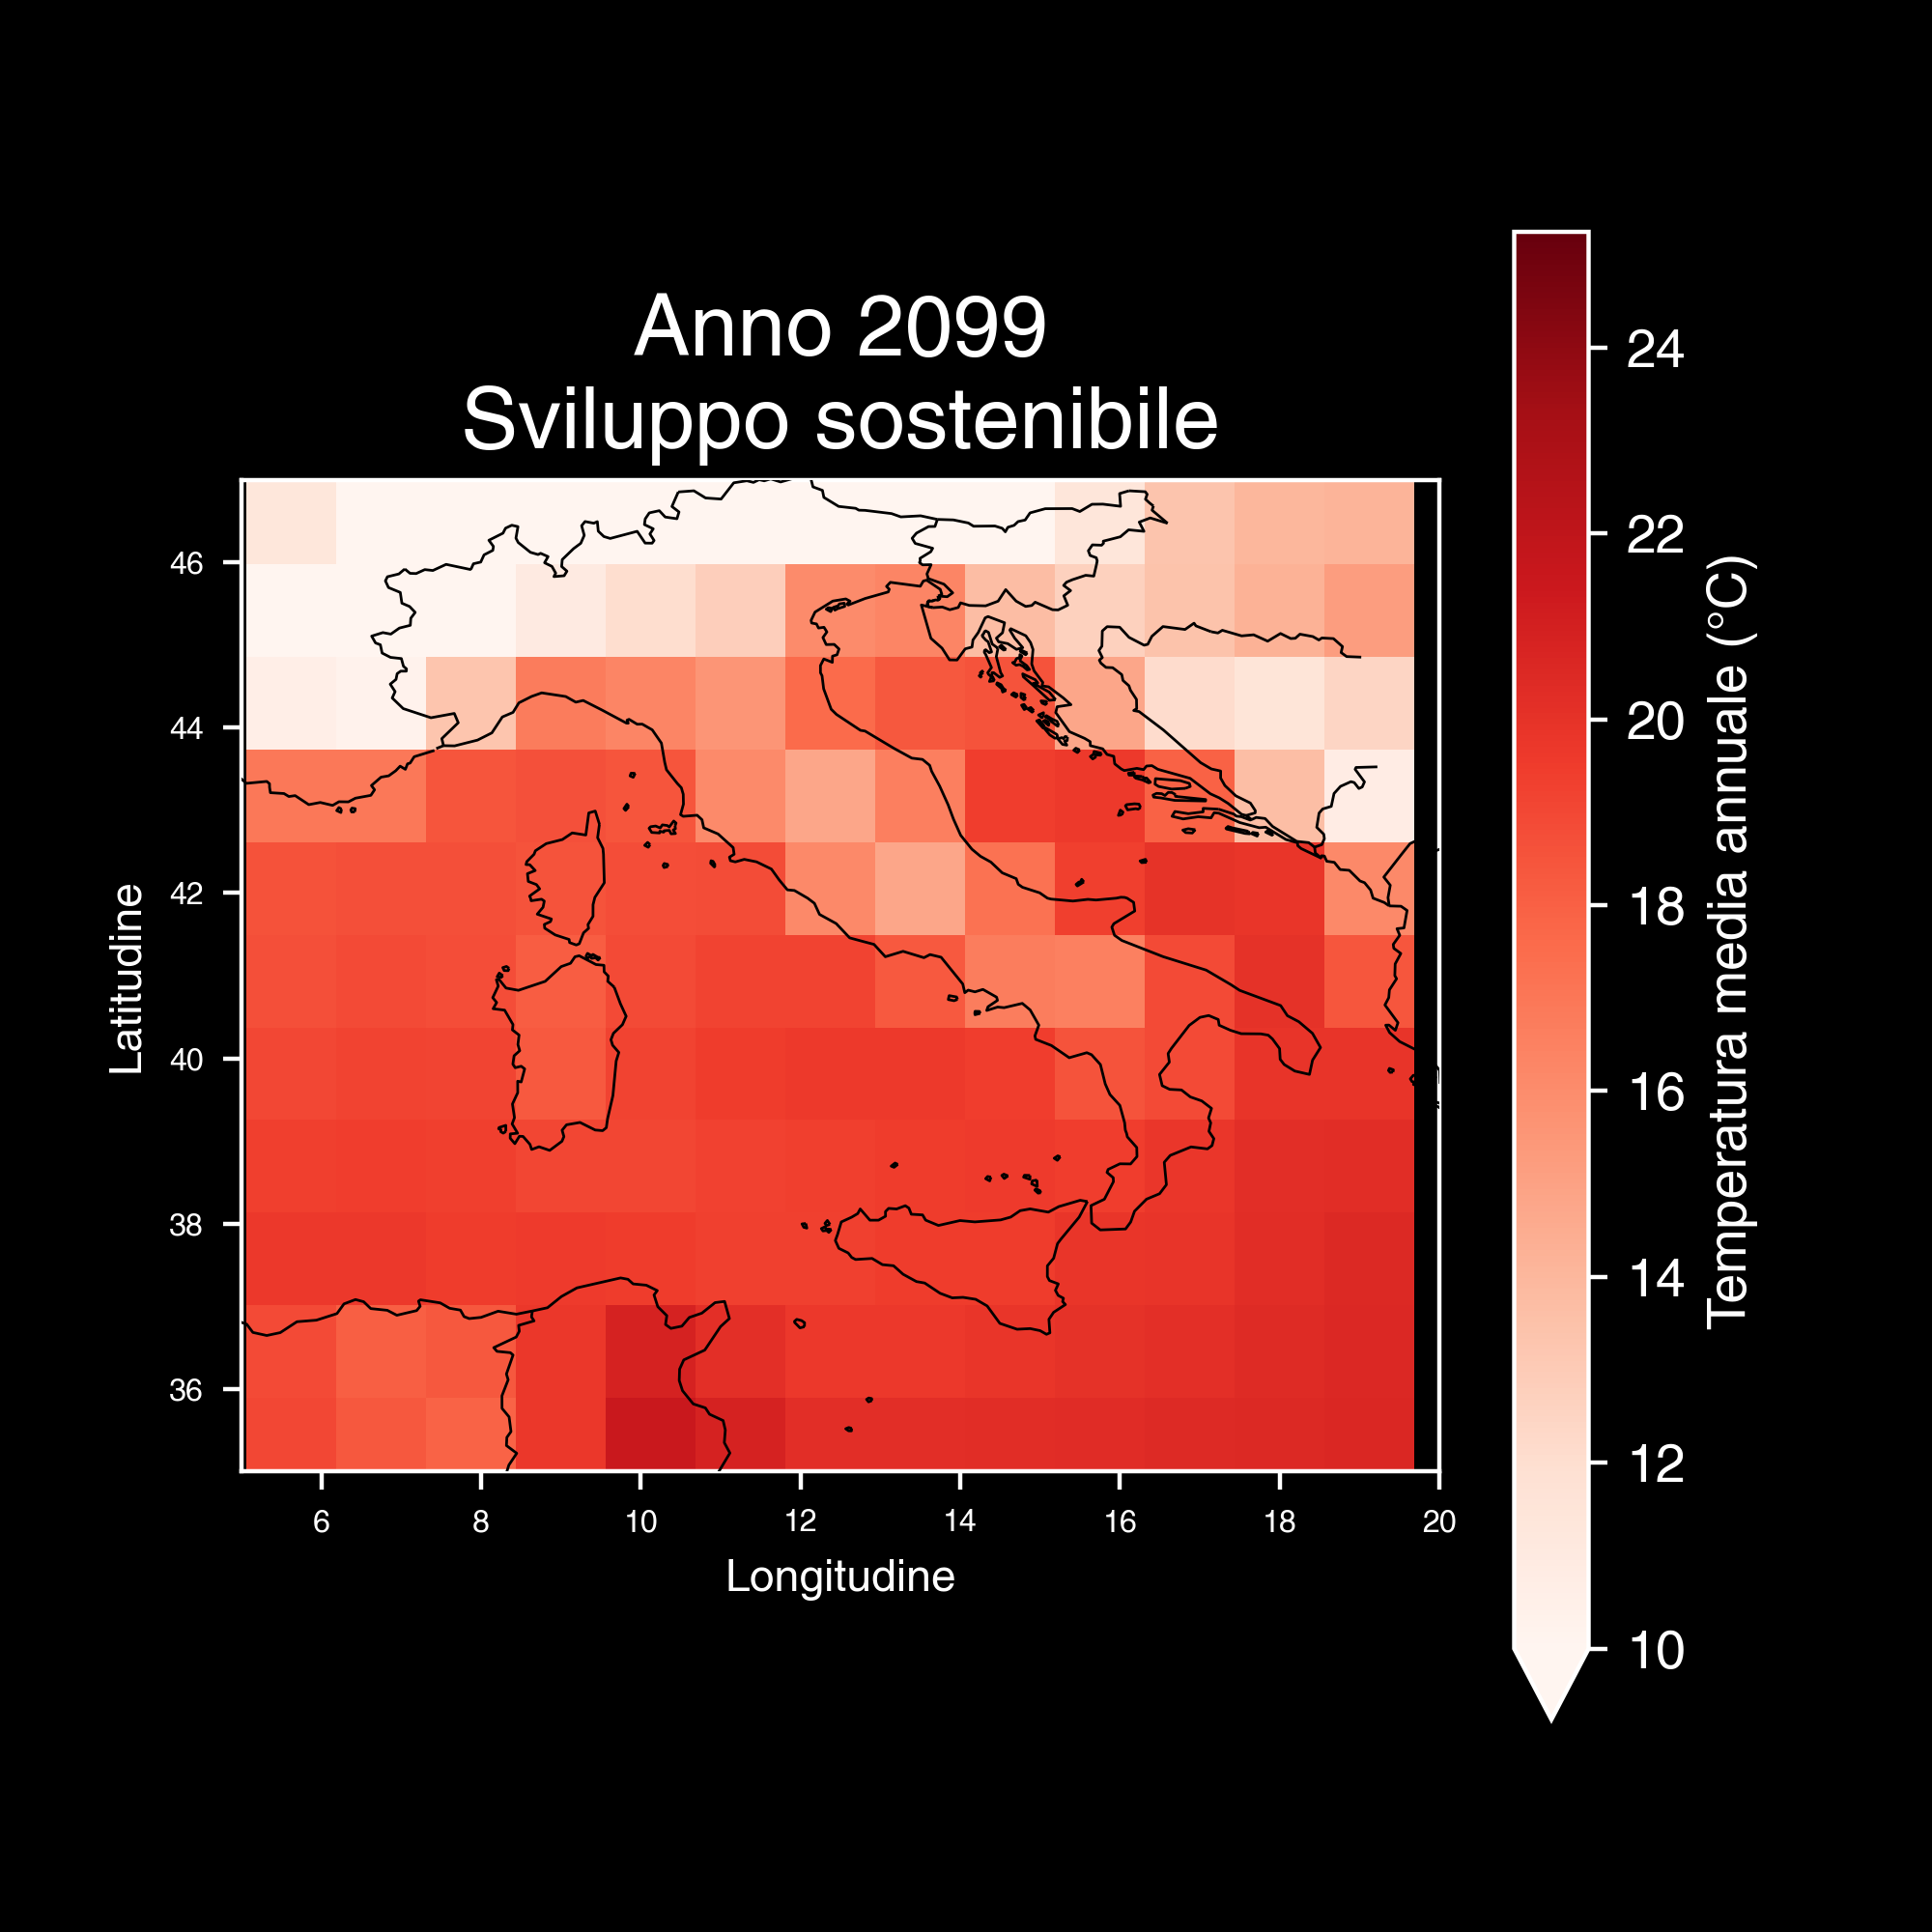
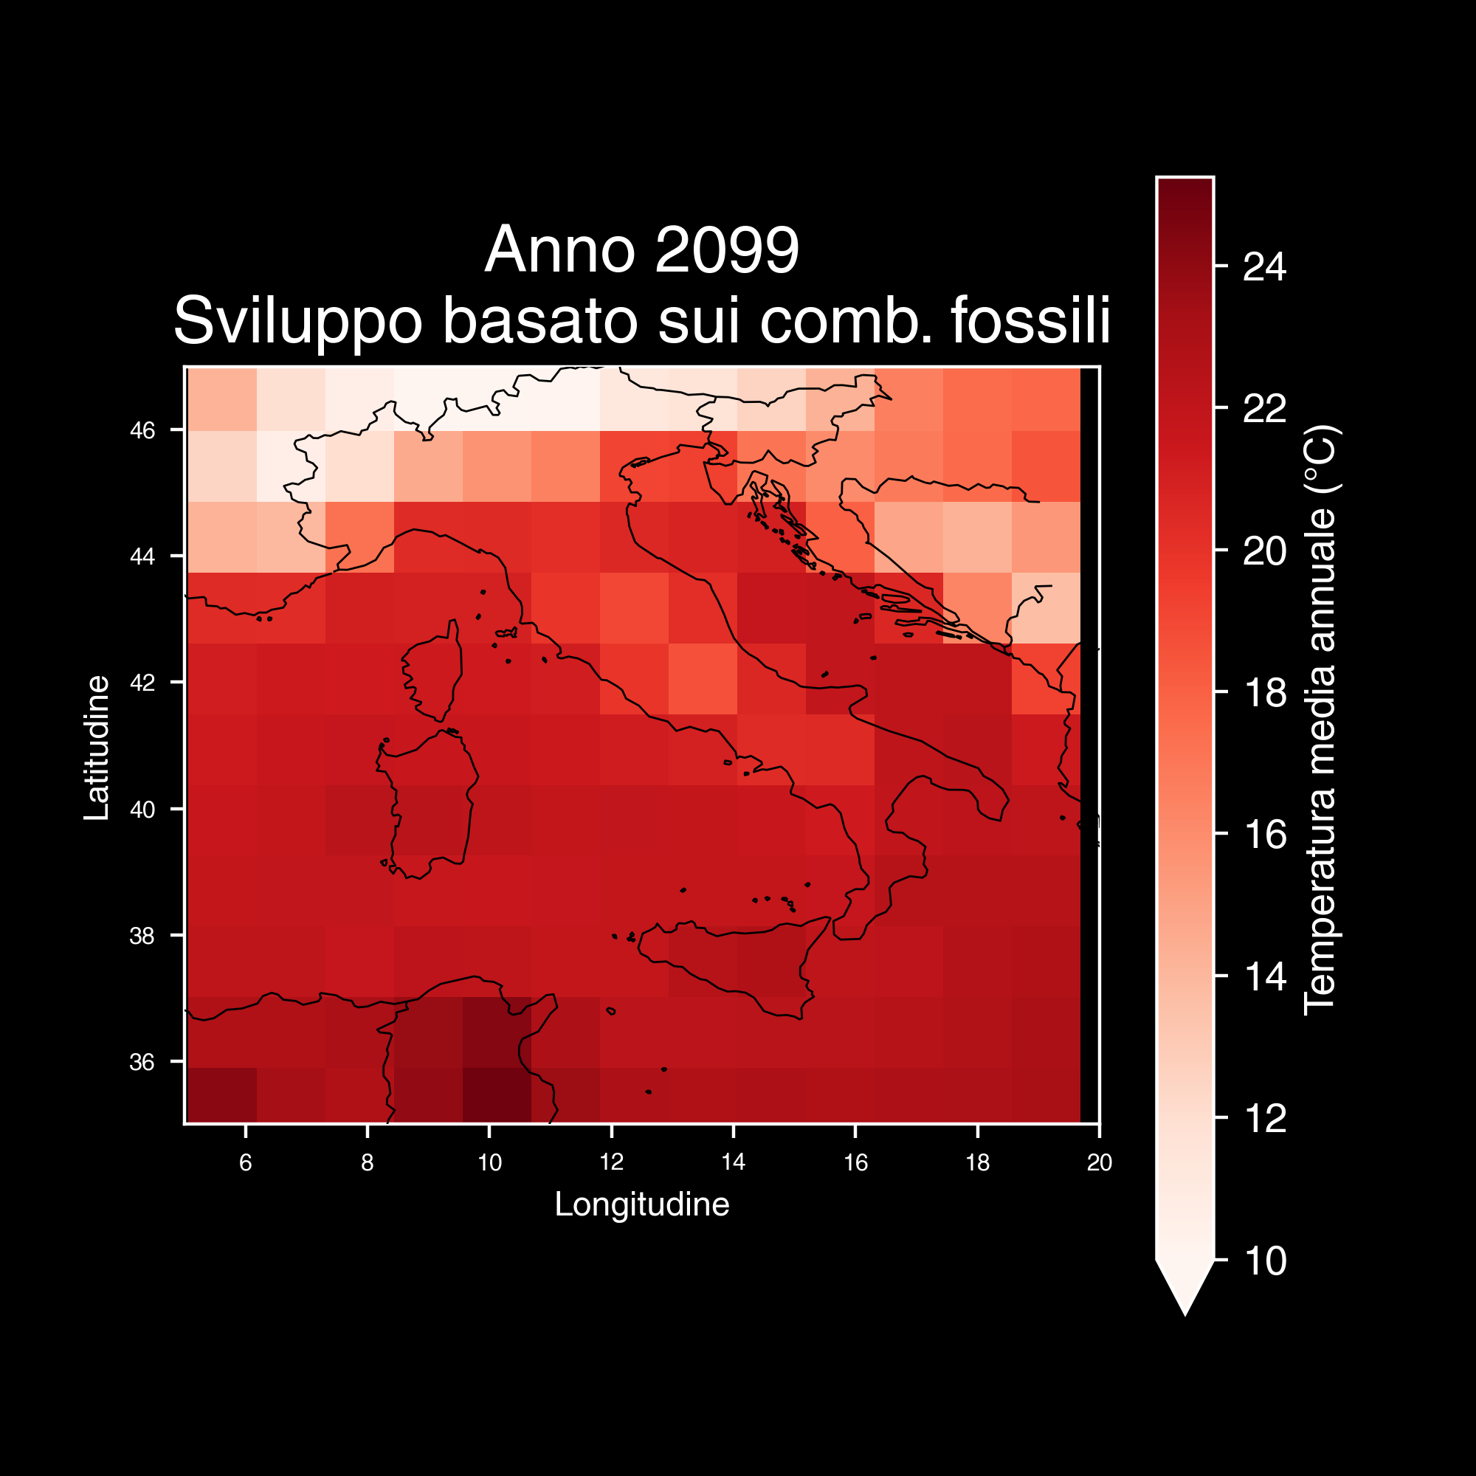

Slide 54
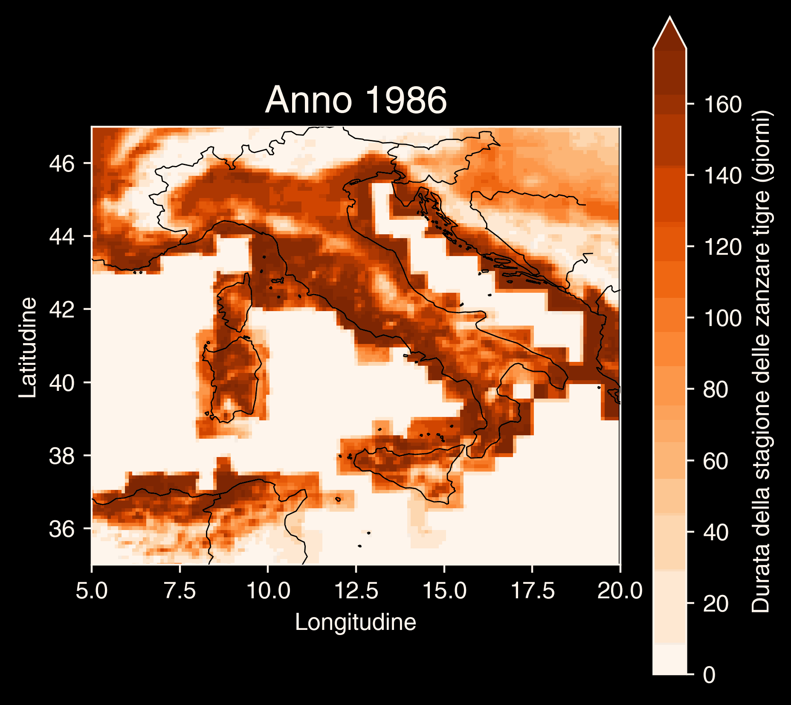
Copernicus Climate Change Service, Climate Data Store, (2019): Climatic suitability for the presence and seasonal activity of the Aedes albopictus mosquito for Europe derived from climate projections. Copernicus Climate Change Service (C3S) Climate Data Store (CDS). DOI: 10.24381/cds.d08ed09a

Slide 55

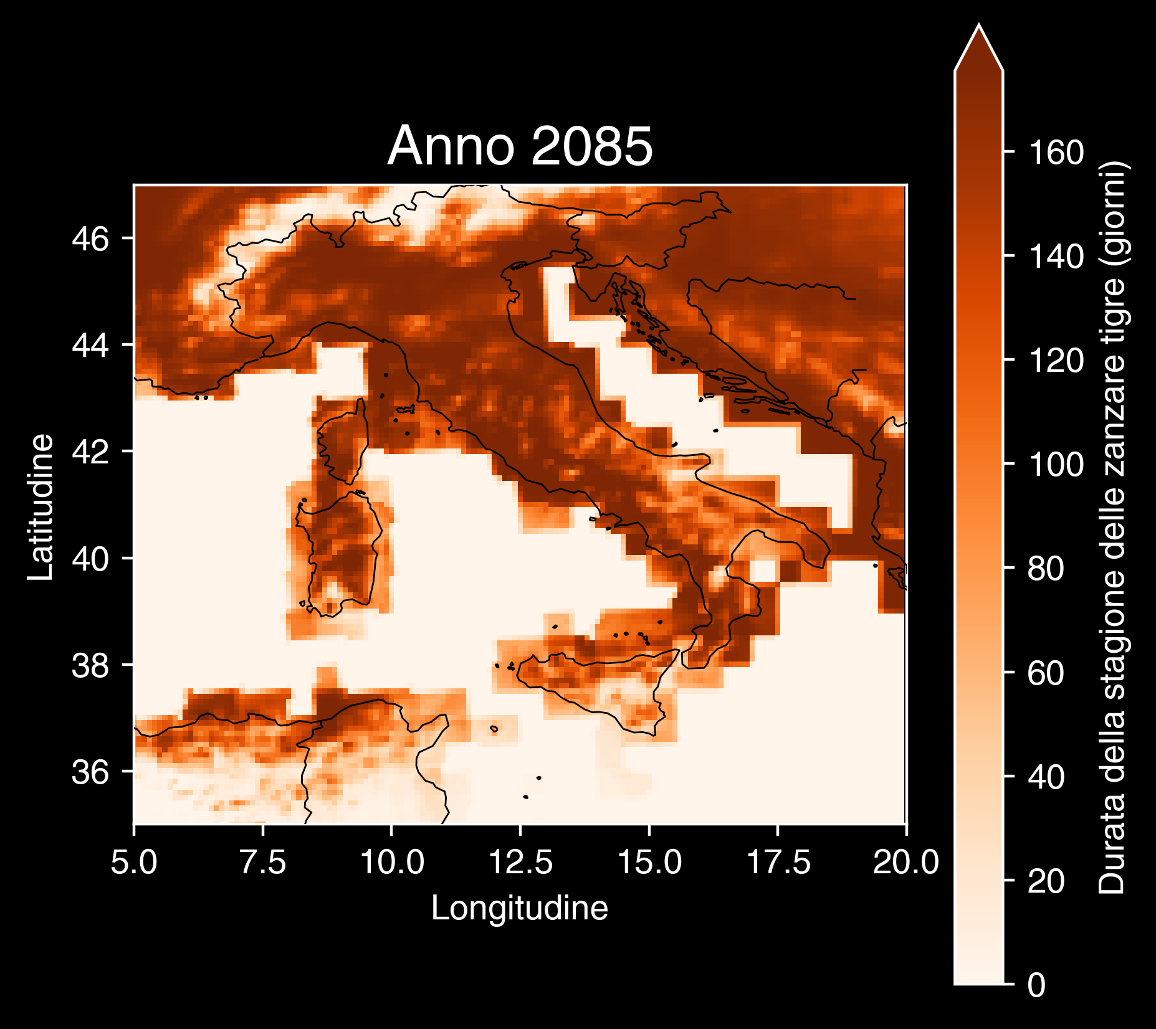
Copernicus Climate Change Service, Climate Data Store, (2019): Climatic suitability for the presence and seasonal activity of the Aedes albopictus mosquito for Europe derived from climate projections. Copernicus Climate Change Service (C3S) Climate Data Store (CDS). DOI: 10.24381/cds.d08ed09a

Slide 56
Le nostre scelte definiscono il cambiamento climatico

Slide 57
🥗Mangiamo consapevolmente.

Slide 58
🥗Mangiamo consapevolmente.
🚲Muoviamoci leggeri/e.

Slide 59
🥗Mangiamo consapevolmente.
🚲Muoviamoci leggeri/e.
🧑‍🚒Seguiamo la Protezione Civile locale.

Slide 60
🥗Mangiamo consapevolmente.
🚲Muoviamoci leggeri/e.
🧑‍🚒Seguiamo la Protezione Civile locale.
🗳️Ricordiamo l’importanza del nostro voto.

Slide 61

https://github.com/Robin-Castellani/pyconit25-future-climate-change

Slide 62

Feedback 👐

